Slide 1
Analysis of Variance
HAP719
Yili Lin

Slide 2
One-Way & Two-Way ANOVA
Aspect | One-Way ANOVA | Two-Way ANOVA
Number of Independent Variables | Only one independent variable | Two independent variables (crossed or nested)
Analysis | Assesses the impact of one categorical factor on a continuous outcome variable | Assesses the impact of two categorical factors on a continuous outcome variable
Main Effects | Examines the main effect of one independent variable | Examines the main effects of two independent variables
Interactions | Does not assess interactions between variables | Assesses interactions between the two independent variables
Hypotheses | Null Hypothesis (H₀): μ₁ = μ₂ = μ₃ = ... = μₖ Alternative Hypothesis (Hₐ): μ₁ ≠ μ₂ ≠ μ₃ ≠ ... ≠ μₖ (where μ₁, μ₂, μ₃, ..., μₖ represent the population means of each group) | Null Hypotheses (H₀): H₀₁: μ₁ = μ₂ = μ₃ = ... = μₐ H₀₂: μ₁ = μ₂ = μ₃ = ... = μᵦ H₀₃: There is no interaction effect (no difference in differences) Alternative Hypotheses (Hₐ): Hₐ₁μ₁ ≠ μ₂ ≠ μ₃ ≠ ... ≠ μₐ Hₐ₂: μ₁ ≠ μ₂ ≠ μ₃ ≠ ... ≠ μᵦ Hₐ₃: There is an interaction effect (differences in differences).
Methods for Analysis | Calculate F-statistic and associated p-value using ANOVA test | Similar to one-way ANOVA, calculate F-statistic and associated p-value for main effects and interaction using ANOVA test.

Slide 3
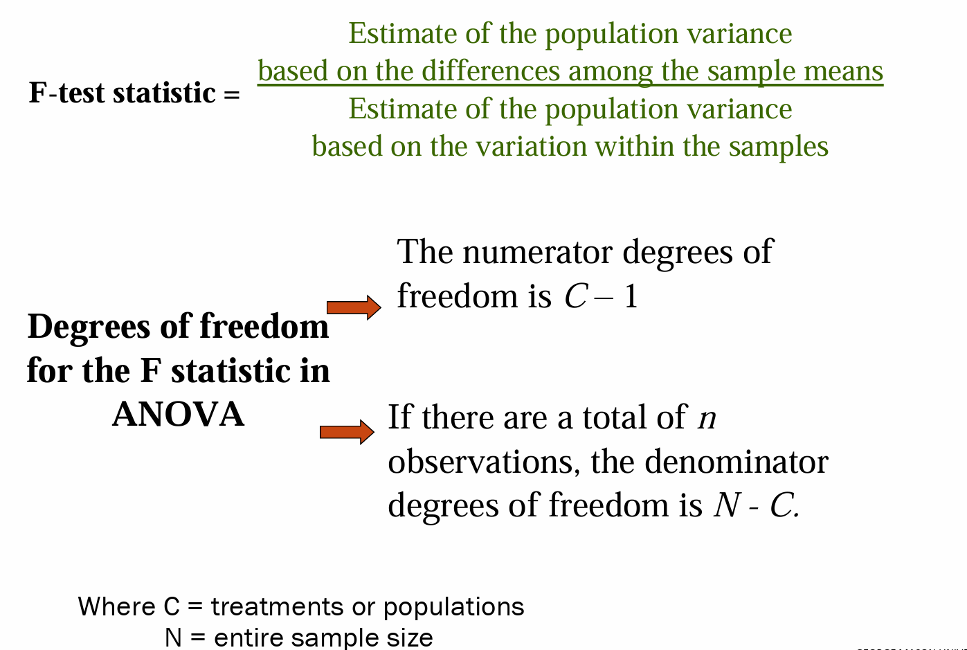
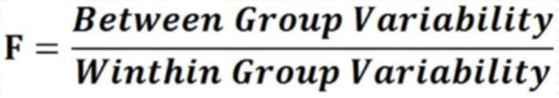
F-test statistic

Slide 4
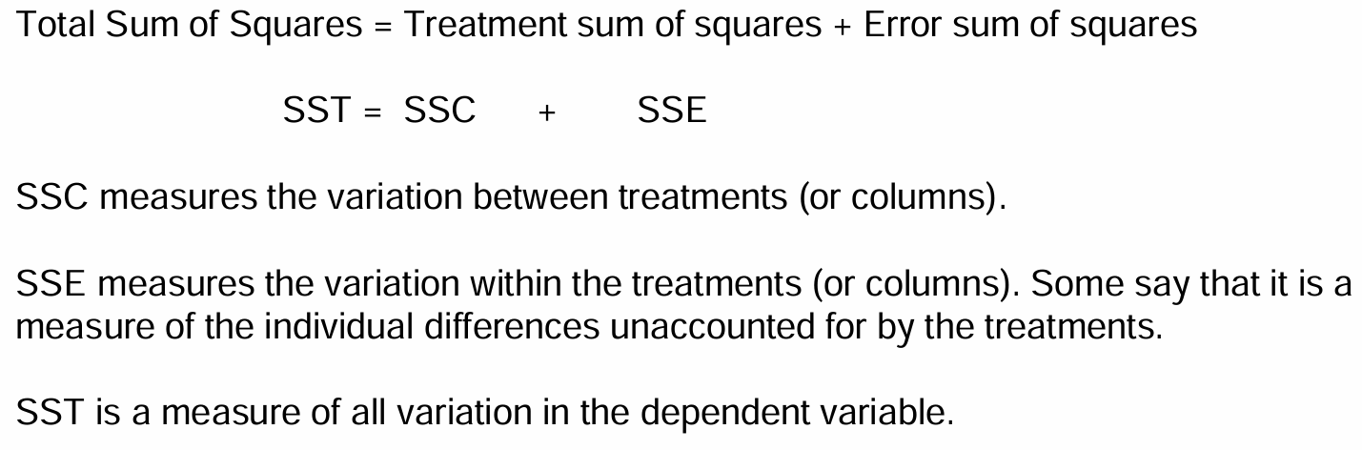


ANOVA divides the Total Variation into the variation due to the treatment (variance explained by the treatment), Treatment Variation, and to the error component (variance unexplained by the treatment), Random Variation.

Slide 5
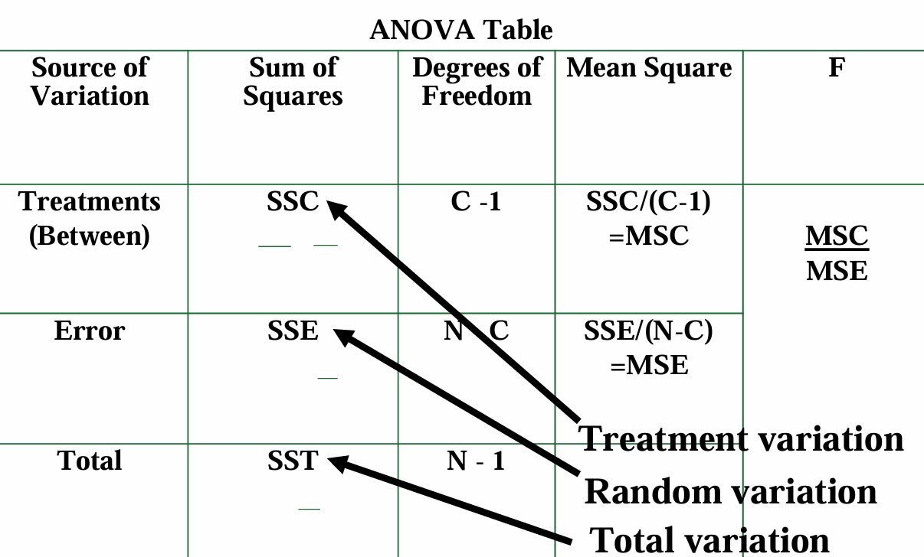

Slide 6
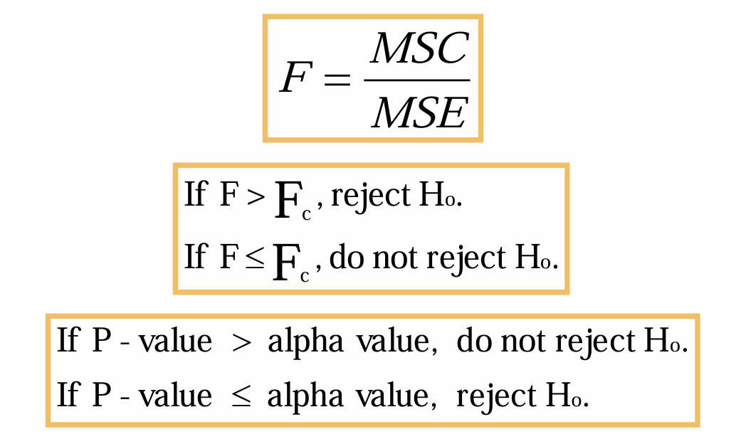
One-Way ANOVA: Procedural Overview
Null Hypothesis (H₀): μ₁ = μ₂ = μ₃ = ... = μₖ
Alternative Hypothesis (Hₐ): μ₁ ≠ μ₂ ≠ μ₃ ≠ ... ≠ μₖ

Slide 7
Two-Way ANOVA
By using a 2-way ANOVA, a researcher:
1. can analyze both variables at the same time in the same design
2. can control for confounding or concomitant variables in a study
3. can explore the possibility of an interaction between the two treatments or categorical variables

Slide 8
Structure of a factorial design: 2-Way ANOVA
A significant main effect for Factor A suggests that Factor A has a significant impact on the dependent variable, regardless of the levels of Factor B.
A significant main effect for Factor B suggests that Factor B has a significant impact on the dependent variable, regardless of the levels of Factor A.
A significant interaction effect suggests that the effect of one independent variable on the dependent variable depends on the level of the other independent variable.

Slide 9
Practice
Which type of ANOVA should be used in the following situations:
A researcher wants to compare the effectiveness of three different types of exercise programs (A, B, and C) on weight loss. They recruit 60 participants and randomly assign them to one of the three exercise programs. After 8 weeks, they measure the weight loss for each participant.
A pharmaceutical company wants to investigate the effects of two factors, Drug Type (A and B) and Dosage (Low, Medium, and High), on the effectiveness of a new medication in reducing blood pressure. They conduct a study with 100 participants, randomly assigning them to one of the six experimental conditions (combination of Drug Type and Dosage).
A medical researcher wants to know if four different medications lead to different mean blood pressure reductions in patients. He randomly assigns 20 patients to use each medication for one month and then measures the blood pressure reduction in each patient.

