Slide 1
Review of Distribution
HAP718
Yili Lin

Slide 2
Properties of the Normal Distribution
• It is a continuous distribution.
• It is symmetric about the mean.
• It is asymptotic to the horizontal axis.
• It is unimodal (one mode).
• The mean, median, and mode are all located in the center of the curve.
• It is a family of curves.
• Area under the curve is 1.
• It is bell-shaped.

Slide 3
Normal Distribution Curve
Mean, median, and mode

Slide 4
Family of Normal Curves

Slide 5
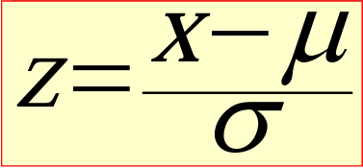
Standardized Normal Distribution

Slide 6
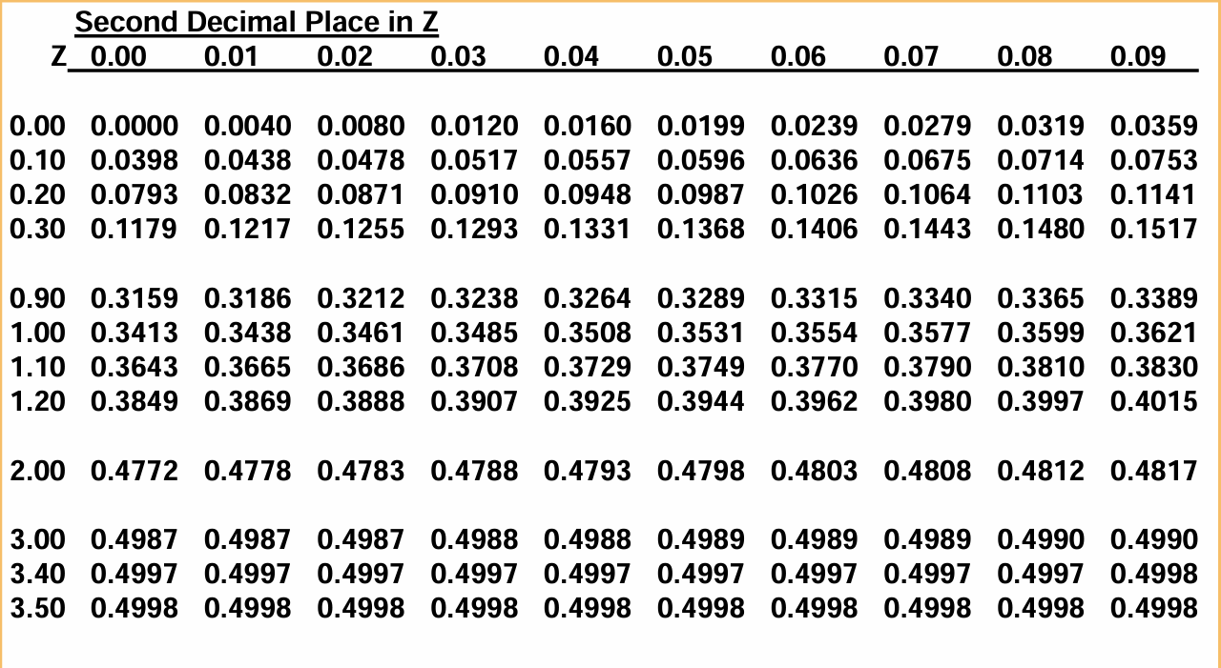
Z Table (an extract)
Note: The first column and first row list the z-scores. All the other values listed in the middle of the table are probabilities.

Slide 7
What is the probability that corresponds to 0.97?

Slide 8
Applying the Z Formula-Example
The mean of days of staying is 10 with a standard deviation of 5, what is the probability that patients stay in the hospital between 10 and 15 days?
Find the P(10<X<15)
We assume that X values are normally distributed.
The first step in solving this would be to convert the X-values to z-scores so that you can use the z-table

Slide 9
Applying the Z Formula-Example
X is normally distributed with µ=10, and σ=5
For X=10, Z= (X-µ)/ σ=(10-10)/5=0
For X=15, Z= (X-µ)/ σ=(15-10)/5=1
P(10≤X≤15)=P(0≤X≤1)=0.3413

Slide 10
Add to weekly assignment
The probability of:
P(X≤12)=?
P(X≥22)=?
P(2≤X≤12)=?

Slide 11
Inferential Statistics -Hypothesis Testing about one or two population means
Steps in Testing Hypotheses:
Establish hypotheses: state the null and alternative hypotheses.
Determine the appropriate statistical test and sampling distribution.
Specify the level of significance.
Calculate the value of the test statistic.
State the statistical conclusion.
Make a healthcare-related managerial decision

Slide 12
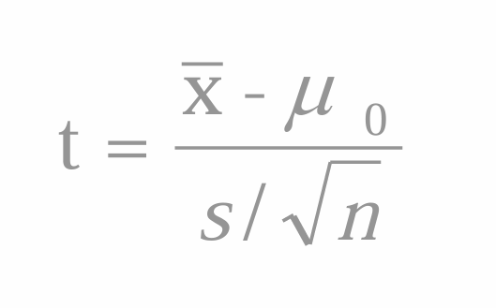
Using the p-Value to Test Hypotheses

Slide 13
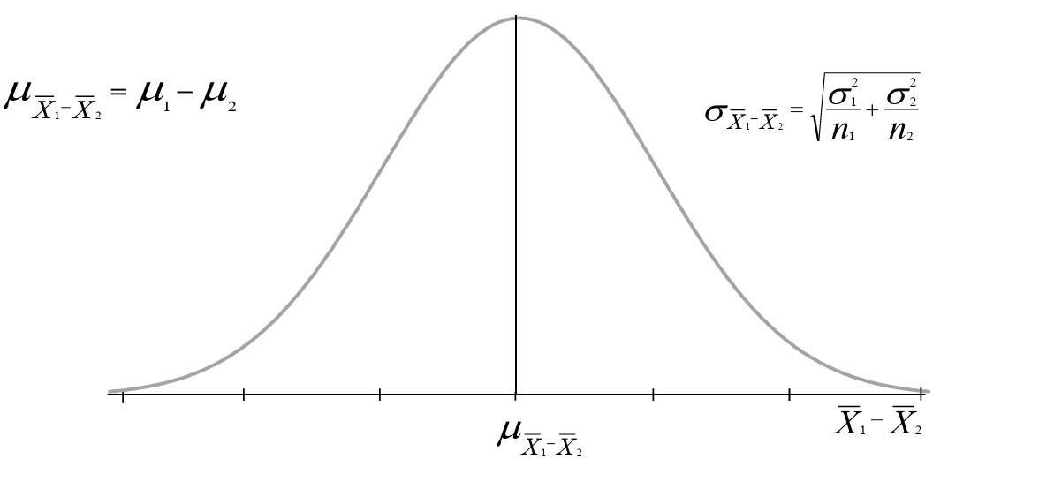
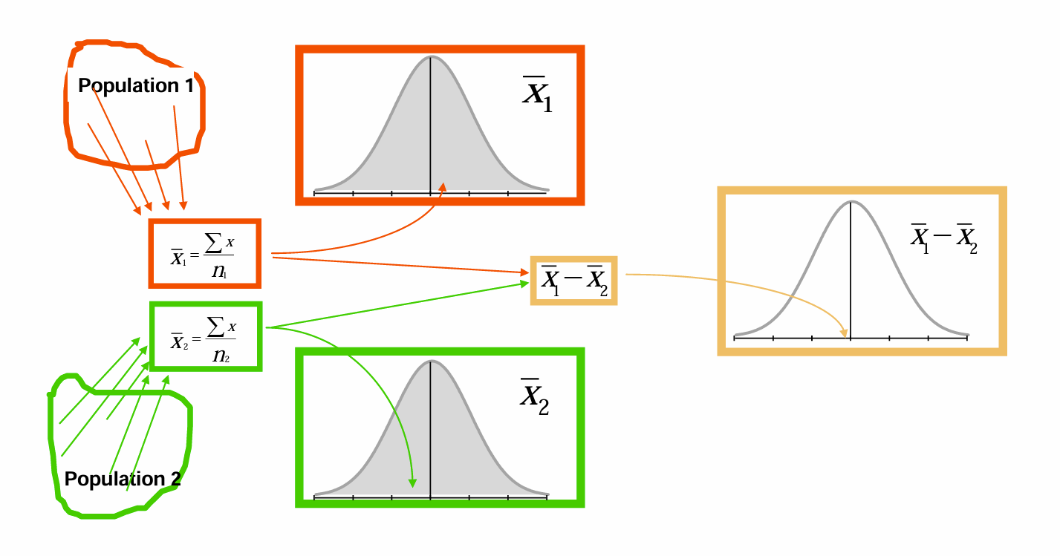
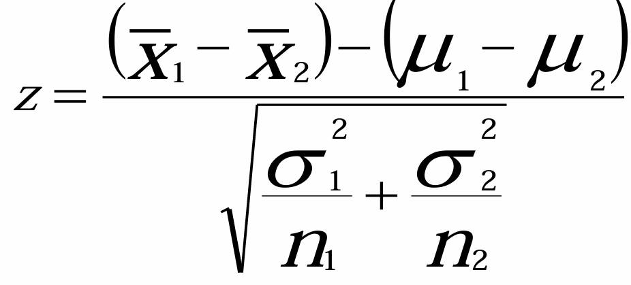
Sampling Distribution of the Difference Between Two Sample Means

Slide 14
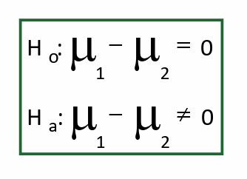
Hypothesis Testing for Differences Between Means

Slide 15
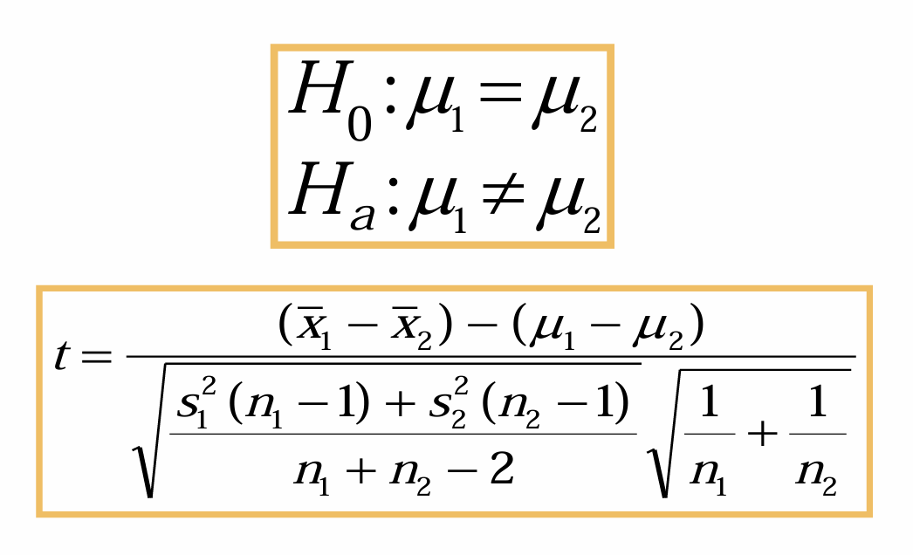
The t Test for Differences in Population Means

