Slide 1
Testing Assumptions for ANOVA in R
HAP 719
Yili Lin

Slide 2
Importance of Testing Assumptions
Assumptions
Normality
Homoscedasticity
Independence of Observations

Slide 3
Importance of Testing Assumptions
Assumptions
Validity

Slide 4
Importance of Testing Assumptions
Assumptions
Validity
Risk of Errors

Slide 5
Testing Before ANOVA
Independence of Observations

Slide 6
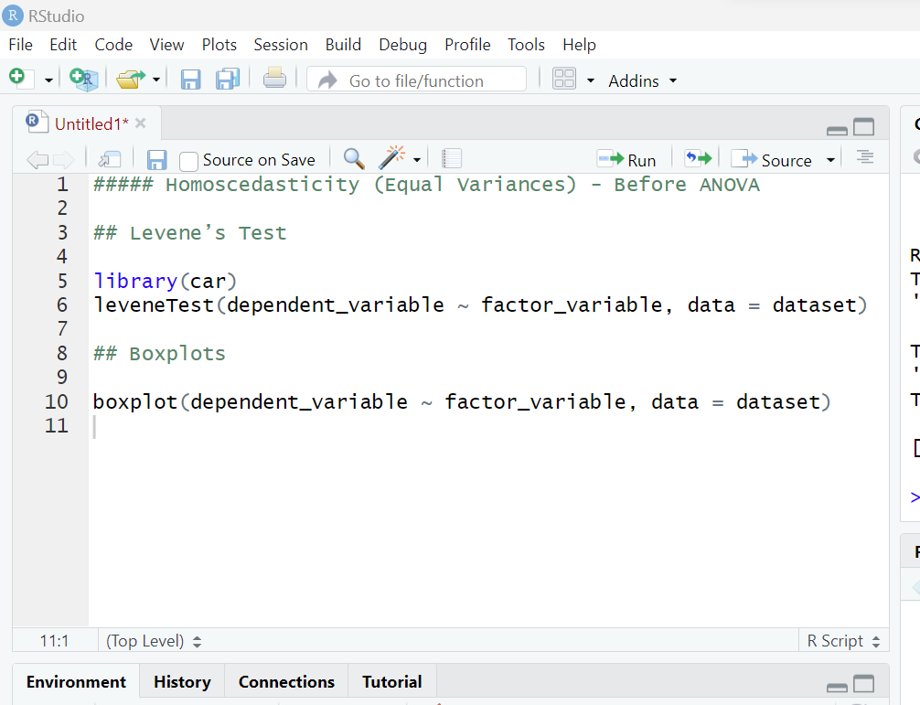
Testing Before ANOVA
Independence of Observations
Homoscedasticity

Slide 7
Testing Before ANOVA
Independence of Observations
Homoscedasticity

Slide 8
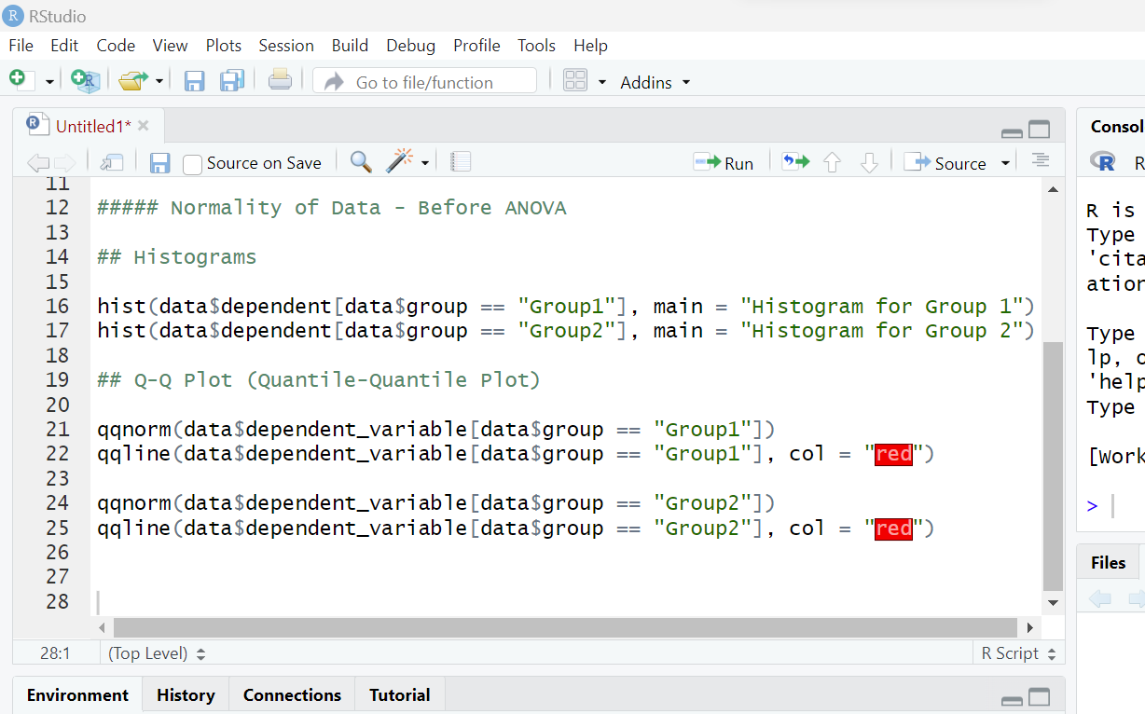
Testing Before ANOVA
Independence of Observations
Homoscedasticity
Normality of Data

Slide 9
Testing Before ANOVA
Independence of Observations
Homoscedasticity
Normality of Data

Slide 10
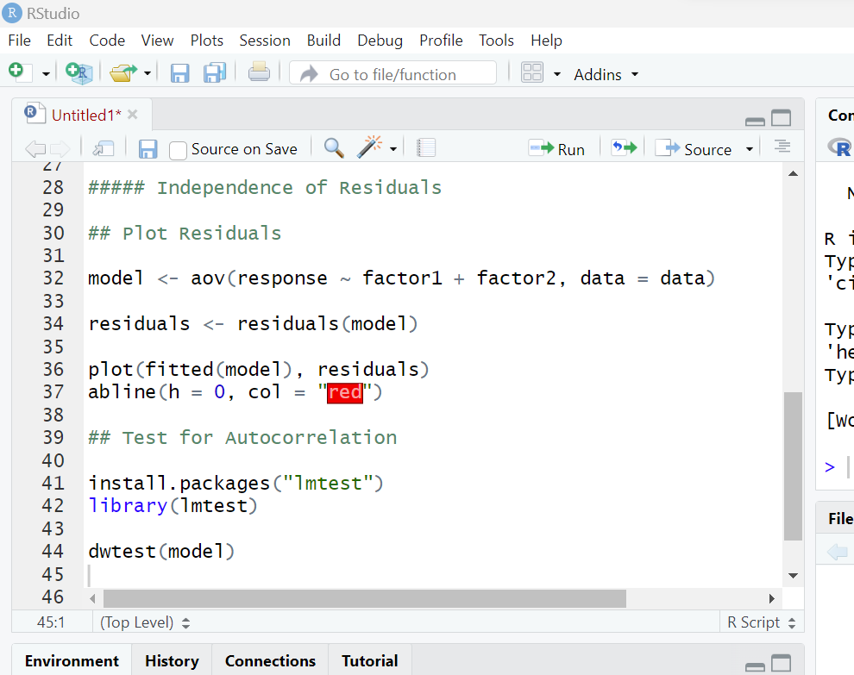
Testing After ANOVA
Independence of Residuals

Slide 11
Testing After ANOVA
Independence of Residuals

Slide 12
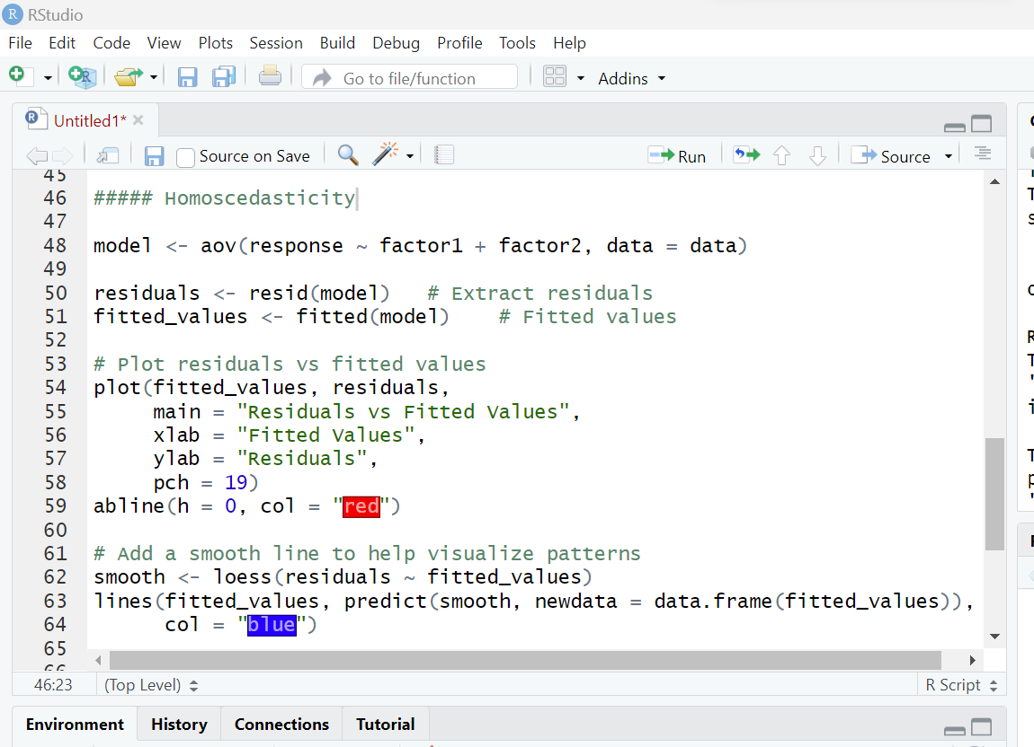
Testing After ANOVA
Independence of Residuals
2. Homoscedasticity

Slide 13
Testing After ANOVA
Independence of Residuals
2. Homoscedasticity

Slide 14
Testing After ANOVA
Independence of Residuals
2. Homoscedasticity

Slide 15
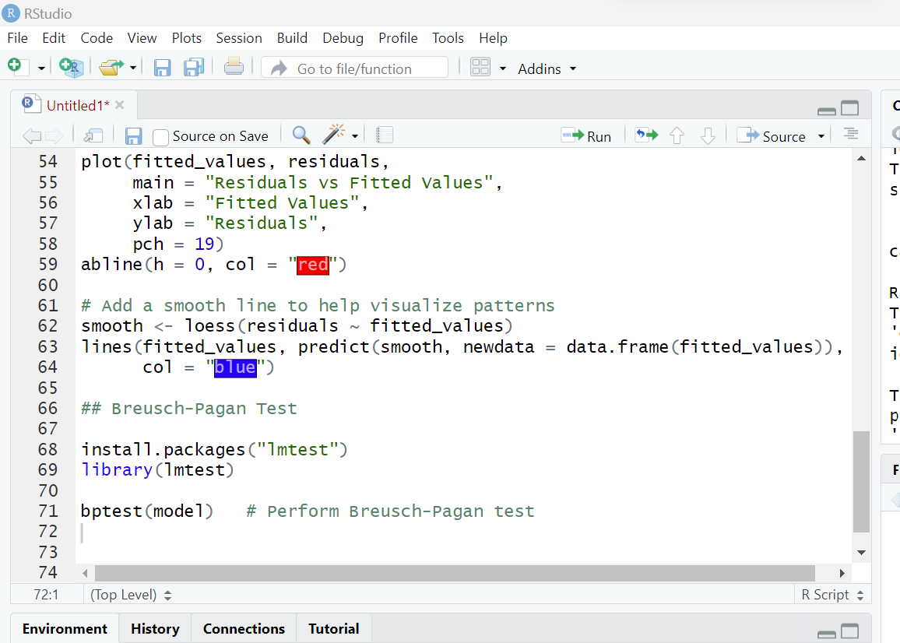
Testing After ANOVA
Independence of Residuals
2. Homoscedasticity

Slide 16
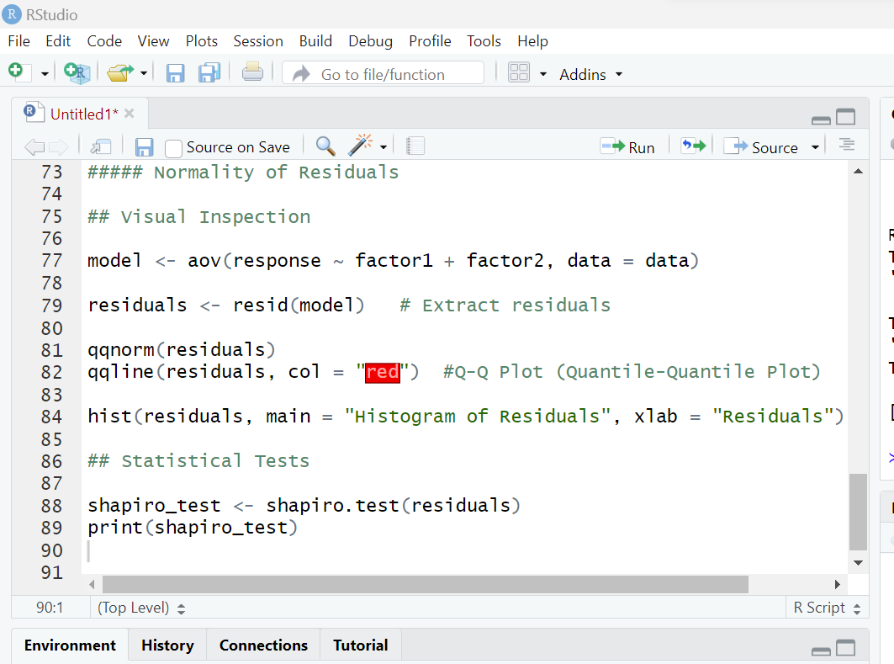
Testing After ANOVA
Independence of Residuals
2. Homoscedasticity
3. Normality of Residuals

Slide 17
Testing After ANOVA
Independence of Residuals
2. Homoscedasticity
3. Normality of Residuals

Slide 18
Testing After ANOVA
Independence of Residuals
2. Homoscedasticity
3. Normality of Residuals

Slide 19
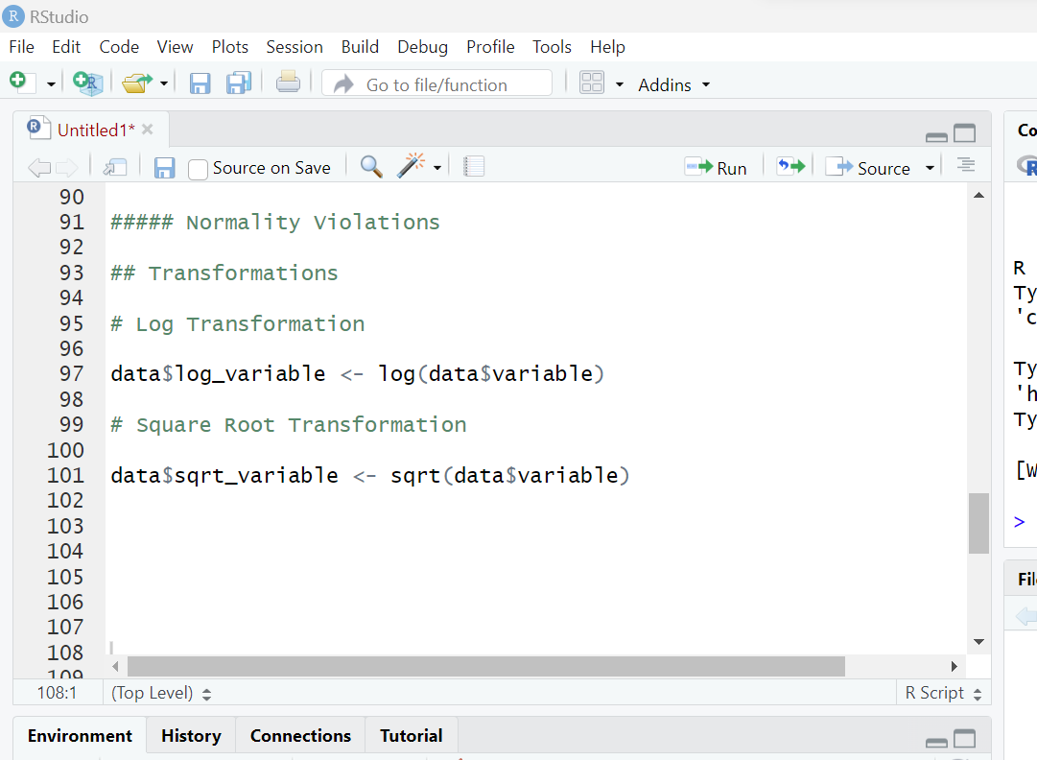
Dealing with Violations of Assumptions
Normality Violations
Transformations
(log, square root)

Slide 20
Dealing with Violations of Assumptions
Normality Violations
Transformations
(log, square root)

Slide 21
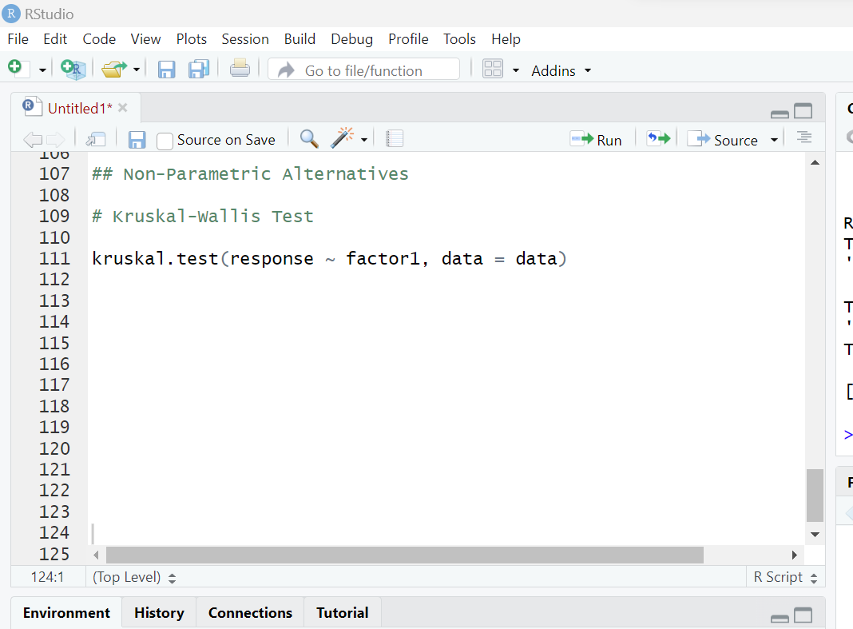
Dealing with Violations of Assumptions
Normality Violations
Transformations
(log, square root)
Non-Parametric Alternatives

Slide 22
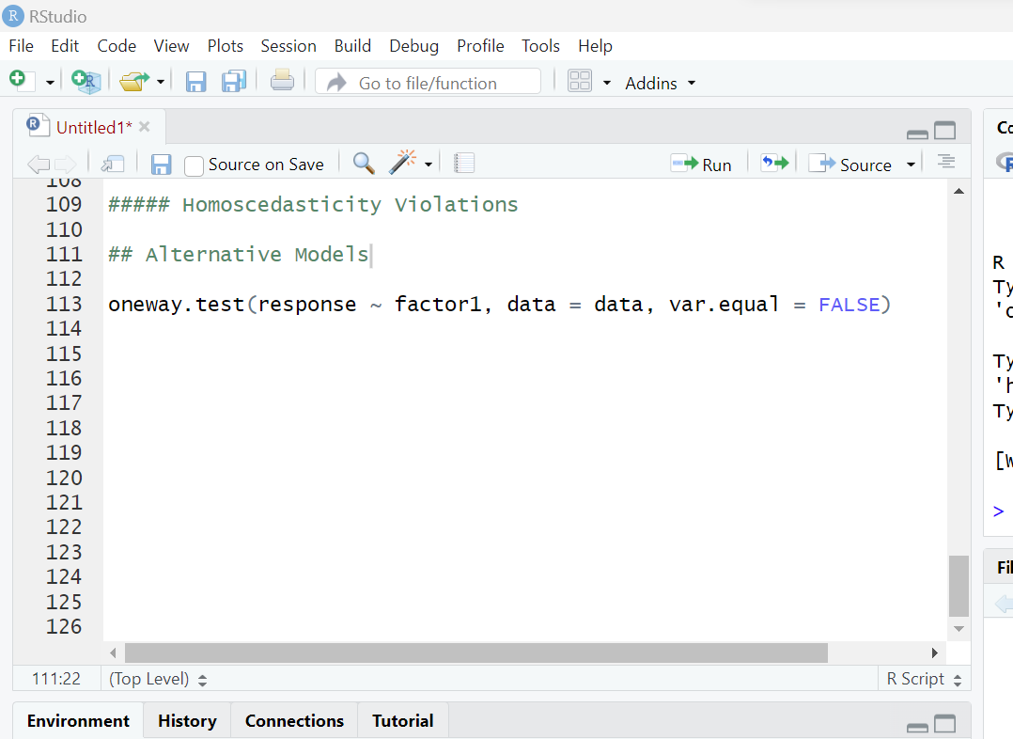
Dealing with Violations of Assumptions
Normality Violations
2. Homoscedasticity Violations
Welch’s ANOVA

Slide 23
Dealing with Violations of Assumptions
Normality Violations
2. Homoscedasticity Violations
3. Independence Violations
Check the Study Design

Slide 24
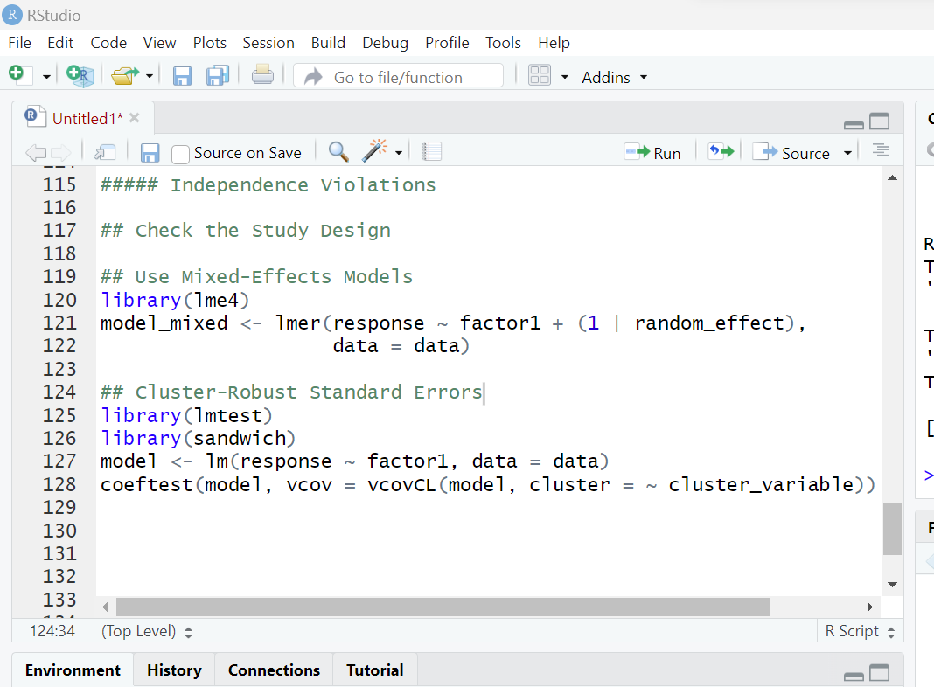
Dealing with Violations of Assumptions
Normality Violations
2. Homoscedasticity Violations
3. Independence Violations
Check the Study Design
Use Mixed-Effects Models

Slide 25
Dealing with Violations of Assumptions
Normality Violations
2. Homoscedasticity Violations
3. Independence Violations
Check the Study Design
Use Mixed-Effects Models
Cluster-Robust Standard Errors

Slide 26
Thank You!

