Slide 1
Defining Probability
Farrokh Alemi Ph.D.
Notes:
This lecture is organized by Dr. Alemi. The lecture is based in part on the OpenIntro Statistics book.

Slide 2
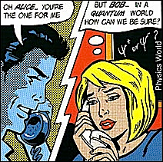
Notes:
We quantify the probability of an event so that we can make tradeoffs among uncertain events, measure the combined impact of several uncertain events or communicate our uncertainty about future events to each other.

Slide 3
Definition
Element
Event
Notes:
An element is the smallest unit of analysis. It is counted to construct events. For example, in analysis of medication errors visits may be considered an element. Events are a grouping of elements. For example, all visits in which a medication error has occurred may be considered the medication error event.

Slide 4
Definition
Universe of possibilities
Venn diagram
Notes:
A collection of all possible events is the universe of possibilities. A Venn diagram shows the universe of possibilities, events and sometimes (though not usually) the elements.

Slide 5
What is probability?
All possible events
Notes:
Venn diagram is very useful in having intuitions about probabilities. To create a Venn diagram we start with a rectangular that depicts all possible events.

Slide 6
What is probability?
All possible events
Event A
Notes:
The yellow circle shows the frequency of event A among all possible events. The blue portion of the rectangle shows the frequency of events that are not A. This visualization helps us define probability.

Slide 7
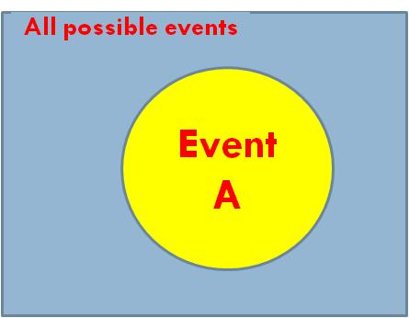
What is probability?
Probability of A =
Notes:
The best way to think of probability is as the ratio of all ways in which an event may occur divided by all possible events. In short, probability is the prevalence of the event among the possible events. Count what is possible and ways in which the event of interest may occur and you can calculate a probability score.

Slide 8
What is probability?
Notes:
The probability of a small business failing is then the number of business failures divided by the number of small businesses. Here the rectangular represents all businesses and the yellow circle shows failing businesses. The ratio of the two shows the probability of failing business.

Slide 9
What is probability?
Notes:
The probability of an iatrogenic infection in the last month in our hospital is the number of patients who last month had an iatrogenic infection in our hospital divided by the number of patients in our hospital during last month.

Slide 10
Law of Large Numbers
Notes:
Probability can be calculated from repeated observations. Suppose we want to know what is the probability of rolling a die and getting a one. Theoretically this is one divided by six as there are six possible numbers on the die and the number we want to get is one of them.

Slide 11
Law of Large Numbers
Notes:
The Y axis shows the estimate of the probability

Slide 12
Law of Large Numbers
Notes:
The X axis shows the number of time we have thrown the dice.

Slide 13
Law of Large Numbers
Notes:
In a small number of trials, in this case in the first 10 trial, the probability of getting one out of six could be way off.

Slide 14
Law of Large Numbers
Notes:
As the number of rolls increases, the estimate of the probability converges to the theoretical probability.

Slide 15
Law of Large Numbers
More Observations
Less Error
Notes:
The law of large numbers says that as more observations are collected, the estimate of probability becomes more accurate. This is important because it tells us we can get to the truth by repeated observations.

Slide 16
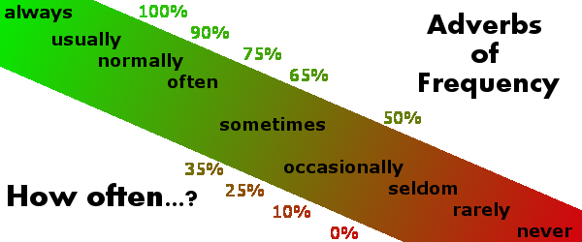
Range of Probability
Notes:
When we are sure something will happen, then the probability of it is one. When we think an event will never happen then its probability is zero. When we are completely uncertain, then the event has a probability of one half or 50% chance of occurrence. All other frequency adverbs do not have an exact numerical probability associated with them.

Slide 17
Odds
Notes:
Some people prefer to describe their uncertainty about an event in terms of odds for the event occurring and not use the concept of probability. The two concepts are related. Odds are expressed as ratios while probabilities are expressed as decimals between 0 and 1. The odds for an event is equal to Probability of the event divided by probability of its complement or 1 minus probability of the event.

Slide 18
Odds
Notes:
If we have the odds and want to calculate the probability of an event we can do so by dividing the Odds of the event by one plus the Odds of the event.

Slide 19
Odds
Notes:
For example, if the probability of an event is 90%

Slide 20
Odds
Notes:
the odds for it is 0.9 divided by 1 minus 0.9. In other words the odds are 9 to one.

Slide 21
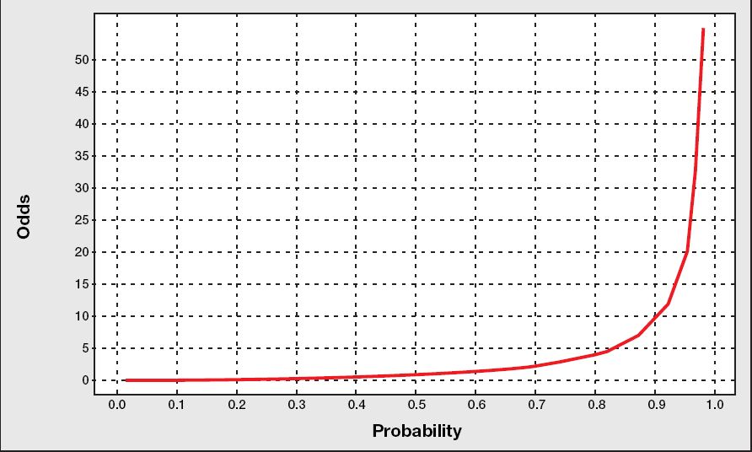
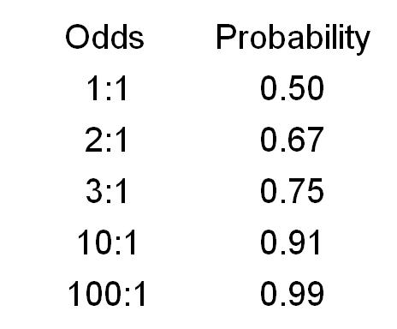
Odds
Notes:
Odds and probabilities are always positive numbers. There is no upper limit to an odd ratio but the maximum probability is 1.

Slide 22
Odds
Notes:
An odds of 1 to 1, implies a 50% chance or a probability of 0.50.

Slide 23
Odds
Notes:
Odds of 2 to 1 increase the probability of the event to 0.66.

Slide 24
Odds
Notes:
Odds of 3 to 1 increases the probability of the event to 0.75

Slide 25
Odds
Notes:
and odds of 4 to 1 increases the probability of the event to 0.8.

Slide 26
Probability as Opinion
Notes:
Managers often talk of probability of one-time events. Many talk of probability of events that have not occurred. For example, a manger may want to know the chances that a particular legislation will limit hospital reimbursement.

Slide 27
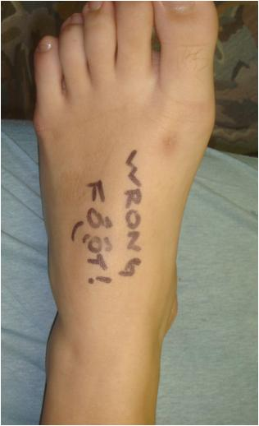
Probability as Opinion
Notes:
Other managers talk of events that occur only once or twice so we cannot reliability sample the event and calculate its probability. For example, they may want to track the probability of wrong side surgeries. In these circumstances, the definition of probability as count of events is not practical. We need a new definition that does not involve counting.

Slide 28
Axiomatic Definition of Probability
Notes:
A number between 0 and 1 can be given to our opinion about the probability of the event. If these numbers meet certain axiomatic restrictions, then the numbers could be considered proper probability functions. Any set of numbers that follow four axioms are defined to be a probability function.

Slide 29
Axiomatic Definition of Probability
1. At least one event must happen
Notes:
The four axioms are the following: First, at least one of the possible events must happen. This is easy and most people agree to this.

Slide 30
Axiomatic Definition of Probability
2. Probability is greater than or equal to zero
Notes:
Second, probability of any event is greater than or equal to zero. Again this is easy. We can agree to assign only positive numbers between 0 and 1 to events of interest.

Slide 31
Axiomatic Definition of Probability
3. P(complement) is one minus P(Event)
Notes:
Third, probability of a complement of an event is one minus the probability of the event. Here again we can agree to this as a reasonable way to hold our opinions about the event.

Slide 32
Axiomatic Definition of Probability
4. P(two mutually exclusive events) is sum of each
Notes:
Fourth the probability of two mutually exclusive event is the sum of each. This last axiom is often violated but we can agree that our numbers should follow this rule. If numbers can be assigned to events such that these four axioms are met, then these numbers are a probability function and follow the calculus of probability. Note that this definition of probability does not require counting of events and is merely based on four assumptions that we can agree to follow.

Slide 33
Opinions Like Probabilities
Notes:
In their thinking, experts may or may not follow the calculus of probability. But what people do and how they should do it are two different issues. People may wish to follow the rules of probability, even though they have not always done so. Experts' opinions may not follow the rules of probability but if experts agree with the axioms are reasonable and should govern their estimates, then such opinions should follow the rules of probability and the calculus of probability can be used to find the implications of their estimates.

Slide 34
Probability As Strength of Belief
On a scale from 0 to 100, where 100 is for sure, how certain are you that medication errors will occur in next visit?
Notes:
Here is an example of how subjective probability can be measured on the basis of intensity of feelings. Several experts familiar with the process can be asked to mark a scale between 0 and 100.

Slide 35
Context for Study of Belief
Notes:
Probabilities, whether counted from events or asked from experts, provide a context to study beliefs. Rules of probability provide a systematic and orderly method for calculating probability of several events from probability of individual events.

Slide 36
Take Home Lesson
Probability is the count of event divided by count of all possible events
Notes:
The take home lesson for this lecture has been that one definition of probability is the count of event of interest divided by count of all possible events

Slide 37
Do One
In examining wrong side surgeries in our hospital, what are the elements, events and the universe of possibilities? Draw the Venn Diagram
Notes:
See if you can answer the following question

