Slide 1
Introduction
Farrokh Alemi, Ph.D.
Notes:
This brief presentation was organized by Dr. Alemi.

Slide 2
Missing Values
Farrokh Alemi, Ph.D.
Notes:
This presentation reviews treatment of missing values in regression analysis.

Slide 3
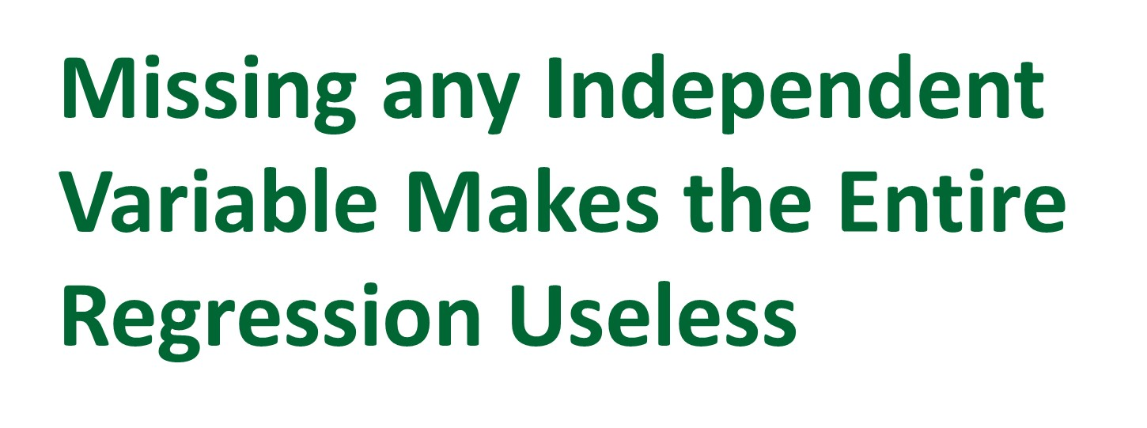
Notes:
Regression variables are selected to work together. When the value of one of the independent variable is missing, the entire regression cannot be conducted.

Slide 4
Notes:
The purpose of this presentation is to show you how you can treat missing values so that regression equation can be used to predict the outcome of interest.

Slide 5
Notes:
Variables can go missing in two ways. At random or not at random. If information is missing at random, there are less concerns about how the missing variable is treated.

Slide 6
Notes:
Let us look at an example. In this study, when blood pressure was missing, it was not at random. It increased the risk of mortality.

Slide 7
Notes:
The first step is to detect if the variable is missing at random.

Slide 8
Notes:
To test if X is missing at random, first set the value of an indicator variable to 1 wherever the value is missing and 0 otherwise,

Slide 9
Notes:
then regress the response variable on the binarized indicator variable for missing X values,

Slide 10
Notes:
In the last step, test if the coefficient of the indicator is significantly related to the response variable.

Slide 11
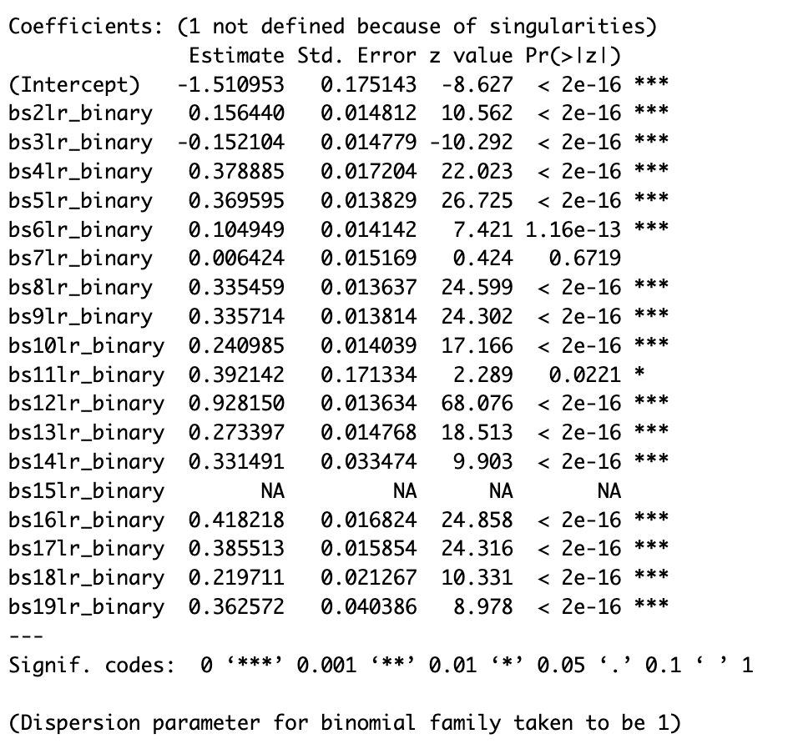
We want to predict the response variable from 19 body systems called bs2lr through bs19lr.
Notes:
Let us look at an example. There are 19 body systems names b,s,2,l,r to b,s,19,l,r.

Slide 12
Indicators: Set to 1 when X is missing and 0, otherwise.
Notes:
For each of these variables we have created an indicator variable that is 1 when the variable is missing and 0 otherwise.

Slide 13
Notes:
For example, the first variable is an indicator variable that is 1 when bs2lr is missing and 0 otherwise and we have called it b,s,2,l,r, binary.

Slide 14
Response variable was regressed on these indicators
Notes:
The response variable was regressed on the indicators.

Slide 15
Notes:
The stars next to the line shows if the indicator variable was significant predictor of response variable.

Slide 16
Missing Everywhere
Notes:
One of the variables, binary variable for body system 15 is missing everywhere and the regression was not able to process this variable. We would drop this variable and body system 15 from the analysis.

Slide 17
Not Missing at Random
Notes:
Variables that are significant predictors of response are said that they are not missing at random.

Slide 18
Missing at Random
Notes:
Variables that are not significant predictors of response are missing at random.

Slide 19
Notes:
Now that you know if a variable is missing at random or not, you can decide how to adjust for it.

Slide 20
Notes:
If the dependent variable is missing, drop it from the analysis. No if or but. If you estimate the missing dependent variable from other variables you would be creating a bias in the data.

Slide 21
Notes:
There are multiple methods for addressing missing independent values depending on whether the variable is missing at random or not at random.

Slide 22
Notes:
If information is missing at random, there is very few concerns about how the missing variable is treated.

Slide 23
Independent Variables
Missing: Drop the case
No Missing Values
Fewer Cases
Notes:
When data are missing at random, deleting the case has no impact on the relationship between independent and dependent variables but will reduce the sample size.

Slide 24
Notes:
Another option is to replace missing values with mean, mode or median.

Slide 25
Independent Variables
Missing: Replace with
Mean, Mode or Median
Notes:
In R you do this through a package called M,I,C,E.

Slide 26
Independent Variables
Missing: Replace with
Mean, Mode or Median
Notes:
Mean imputation is a fast and simple fix for the missing data. However, it will underestimate the variance, disturb the relations between variables, bias almost any estimate other than the mean.

Slide 27
Notes:
Regression imputation replaces missing values of X with predicted value from regression of X on other independent variables.

Slide 28
Independent Variables
Missing: Imputation
# Create object with missing values
mice_data <- mice(data, method = "pmm", m = 5)
Notes:
In R, you can do this through M,I,C,E as well.

Slide 29
Independent Variables
Missing: Imputation
Predictive Mean Matching
# Create object using MICE package
mice_data <- mice(data, method = "pmm", m = 5)
Notes:
You use the option of predictive mean matching in M,I,C,E package.

Slide 30
Independent Variables
Missing: Imputation
# of Imputations Averaged
# Create object with missing values
mice_data <- mice(data, method = "pmm", m = 5)
Notes:
The parameter 5 tells M,I,C,E package to do this 5 times from random samples of the data and take the average of imputed values.

Slide 31
Independent Variables
Missing: Imputation
Unbiased under missing at random
Notes:
Imputation strengthens the relations in the data. Variability is underestimated. It reduces drift in applying the model to other data. However, to do this correctly you must check accuracy of predictions in cross-validation. This approach is unbiased under missing at random.

Slide 32
Independent Variables
Not Missing at Random
Create missing indicators
Visualize patterns of missing
Drop variables always missing
Ignore patterns that apply to few cases
Test significance of missing value indicators
Select common denominator of significant indicators
Drop non significant indicators,
Notes:
Suppose you created missing indicators, visualize patterns of missing, ignored patterns that apply to too few cases, and tested the significant of the missing values.

Slide 33
Independent Variables
Not Missing at Random
Create missing indicators
Visualize patterns of missing
Drop variables always missing
Ignore patterns that apply to few cases
Test significance of missing value indicators
Select common denominator of significant indicators
Drop non significant indicators,
Notes:
You dropped the variables that are not significant and are left with the indicators that are significant predictors and not missing at random.

Slide 34
Independent Variables
Not Missing at Random
Now What Do You Do
Create missing indicators
Visualize patterns of missing
Drop variables always missing
Ignore patterns that apply to few cases
Test significance of missing value indicators
Select common denominator of significant indicators
Drop non significant indicators,
Notes:
You dropped the variables that are not significant and are left with the indicators that are significant predictors and not missing at random.

Slide 35
Independent Variables
Not Missing at Random
Include missing variable indicators as additional variables
Notes:
Include missing variable indicators as additional variables in the model.

Slide 36
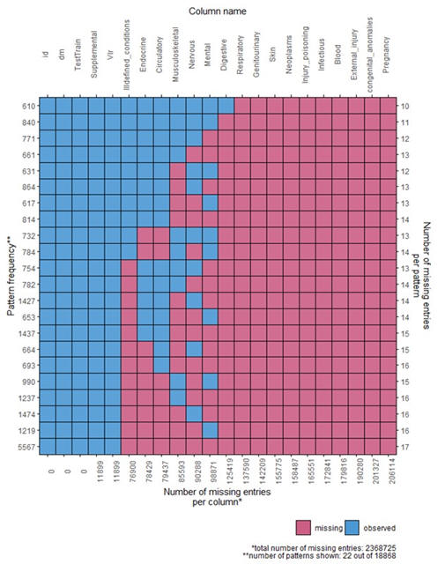
Notes:
Here is an example output. M,I,C,E package gives you visual display of where variables are missing. Red indicates a case in which the data is missing..

Slide 37
Notes:
In situations where you see a lot of red in the same row, then there are possible interactions among indicators. Look at the pattern of missing across indicators and see if a the common denominator of the indicators can explain a lot of the data. For example, we see that the last row has a lot of missing

Slide 38
Notes:
but the common set of missing is to the right where it is missing from first to last row in this portion of the data. This is where you can come up with an interaction term to adjust these values in a way that is different from all other adjustments.

Slide 39
Patterns of Missing Call for Special Adjustments
Notes:
Patterns of missing provide information for unique types of adjustments that need to be tested in cross validation.

Slide 40
Notes:
Missing variables can be addressed in different ways, but you need to pay attention to if they are missing at random and whether there are patterns among missing indicators.

Slide 41
Check Other Videos We have on Regression
Thank you
Notes:
Thank you. Make sure you look at other videos we have created on regression analysis.

