Slide 1
One way ANALYSIS OF VARIANCE (ANOVA)
Farrokh Alemi, Ph.D.
Notes:
These slides were organized by Professor Alemi

Slide 2
Purpose of ANOVA
One-way
Two-way
Factorial
Notes:
One way analysis of variance examines if the observations are changing as one variables changes. Two way analysis of variance does so over two variables. Factorial design does so over combination of 2 or more variables. A factorial design includes all combination of the variables.

Slide 3
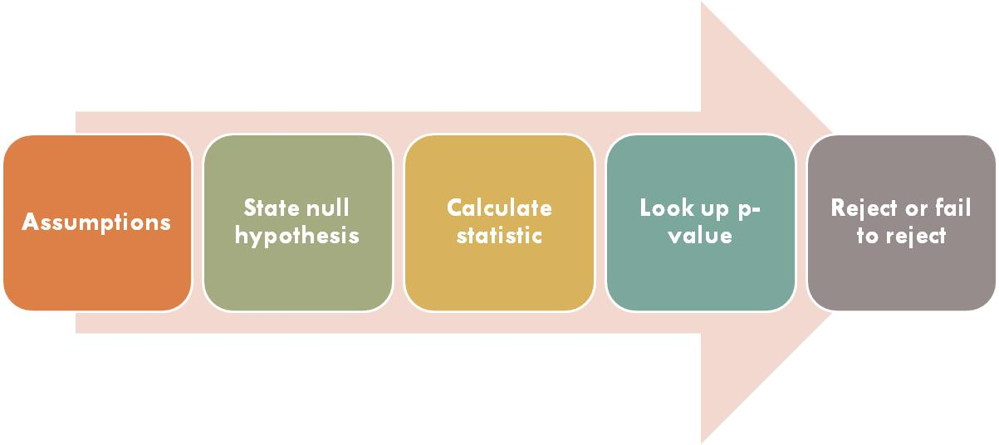
Framework for Hypothesis Testing
Notes:
Recall the framework for hypothesis testing. First we examine the assumptions, then state the hypothesis, calculate the statistic, look up the p value and then decide to reject or fail to reject the null hypothesis.

Slide 4
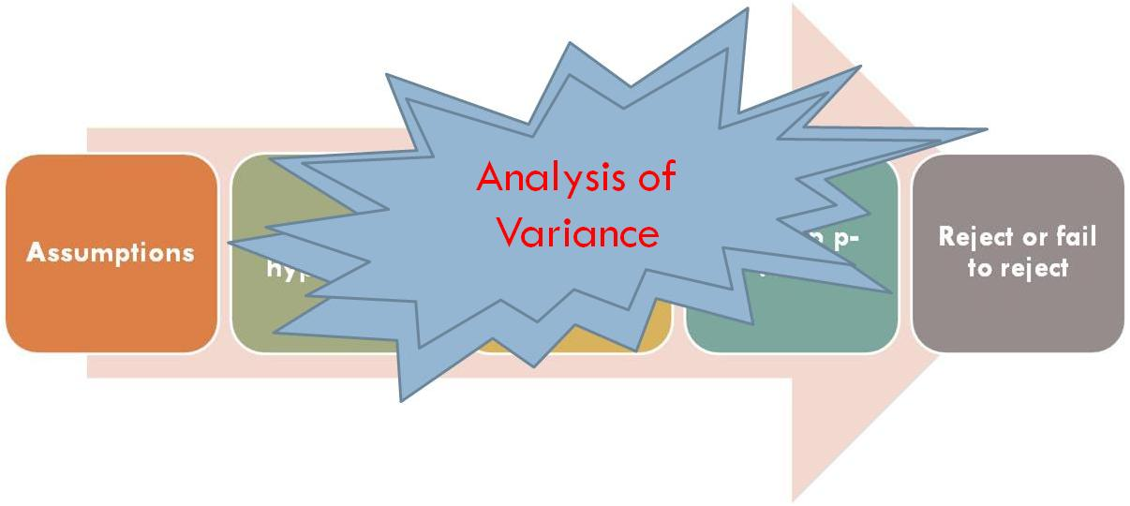
Framework for Hypothesis Testing
Notes:
In this set of slides we apply this framework to analysis of variance for comparing 3 or more means. We will use One-way Analysis of Variance to test when the mean of a variable differs among three or more groups

Slide 5
Test Assumptions
Independent samples
Independent observations within samples
Dependent variable normally distributed
Population variances are equal
Notes:
There are 4 assumptions in doing one way analysis of variance. First that samples are independent. Second that observations within samples are independent. Third that the dependent variable is normally distributed. Last that population variance is normally distributed.

Slide 6
State Hypotheses
H_{o}: μ₁ = μ₂ = μ₃ = μ₄
H_{a}: Not H_{o}
Any μ₁ ≠ μ₂ or μ₂ ≠ μ₃ or μ₁ ≠ μ3 will reject
Always Two Sided Test
Notes:
The hypothesis is that all means for the samples are equal. The alternative hypothesis is that at least one mean is different.

Slide 7
Calculate Test Statistics
Notes:
Test statistic for ANOVA is based on between & within groups Sun of Squared Residuals

Slide 8
Logic Behind the Test Statistic
Partitioning of variance
A. Between Group Variability
B. Within Group Variability
Notes:
Basically we are testing that the sum of squared residuals for between and within group differences are not significantly different

Slide 9
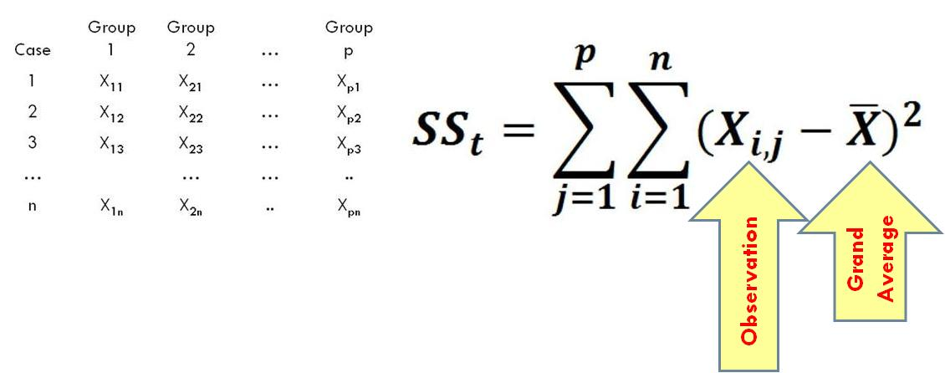
Total Sum of Squares
Notes:
Here we have observations for each case, or each row in the table. We have n rows so n cases. Each observation is compared to grand average. This difference from grand average is called residual. The squared residual is summed. This shows the total sum of square which is a measure of variability for all observations.

Slide 10
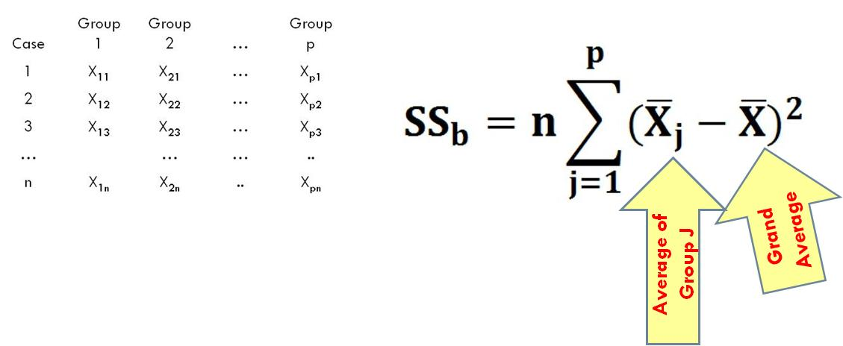
Between Groups Sum of Squares
Notes:
For between sum of square we examine the variability for the average of samples and the grand average. If each of the n cases had exactly the average value for the sample, then the sum of square of the residuals for between samples is n times the sum of squared difference between average sample and grand average. Thus, we are examining how much variability occurs between samples.

Slide 11
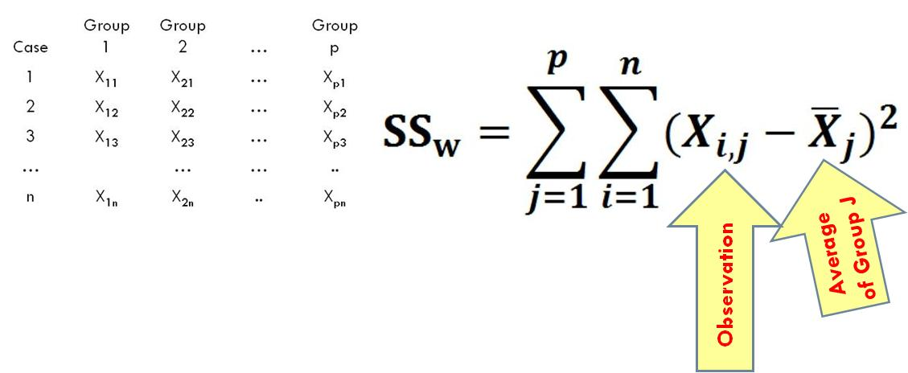
Within Groups Sum of Squares
Notes:
Within group sum of squares is calculated as the sum of the observations for each case and the average within the group that the case belongs. Note that here we are examining the difference between observations and the average of the sample the observations belongs to.

Slide 12
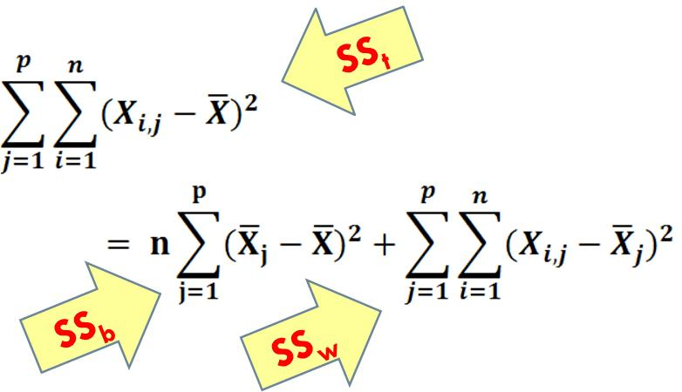
Partitioning of Variance
Notes:
The total sum of square residuals can be partitioned to between and within sample sum of squared differences. This says that the total variability is a function of the variability within the group and between the groups.

Slide 13
Calculating Test Statistics
Notes:
The F statistics is calculated as the ratio of the Mean of the sum of the squared between and within groups. To calculate the F statistics we need to divide the sum of the squared residuals by the degree of freedom within group and between groups.

Slide 14
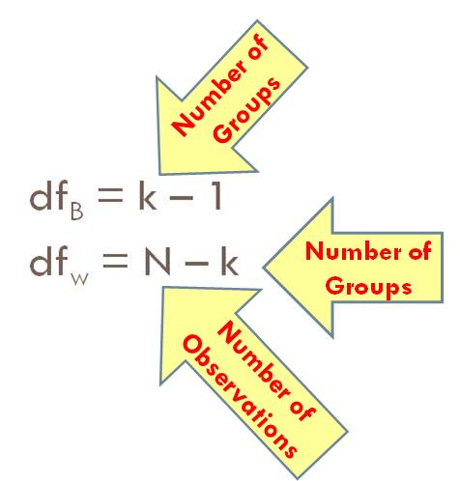
Calculation of Degrees of Freedom
Notes:
The degrees of freedom between groups is the number of groups minus 1. The degrees of freedom within groups is the number of observations minus number of groups

Slide 15
Reject or Fail to Reject
α = .05
If F_{c} > F_{α} Reject H₀
If F_{c} > F_{α} Can not Reject H₀
Notes:
We reject the hypothesis if the calculated F statistic is above F statistic for allowed error rate.

Slide 16
Example: Satisfaction Ratings in Different Hospital Units
Group 1: Patients in 4 West
Group 2: Patients in 4 East
Group 3: Patients in 3 Floor
Notes:
Let us take a look at an example. In this example, we are looking at patients in 3 different hospital wards. We want to know if the patients within these wards have the same satisfaction rate.

Slide 17
Example: Satisfaction Ratings in Different Hospital Units
Satisfaction Rating (0-10)
Treatment Conditions (3 Groups)
Notes:
Each patient has independently rated satisfaction with their care on a scale from 0 to 10. Since we are comparing 3 wards then there are 3 groups or 3 treatment conditions.

Slide 18
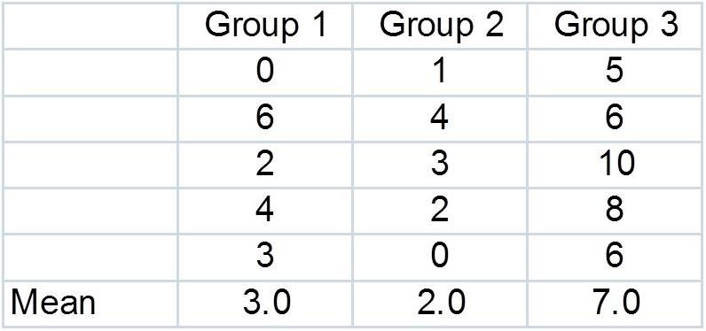
Observations
Notes:
These data show the ratings made in different hospital wards, or in our terminology groups, by 5 patients within these groups.

Slide 19
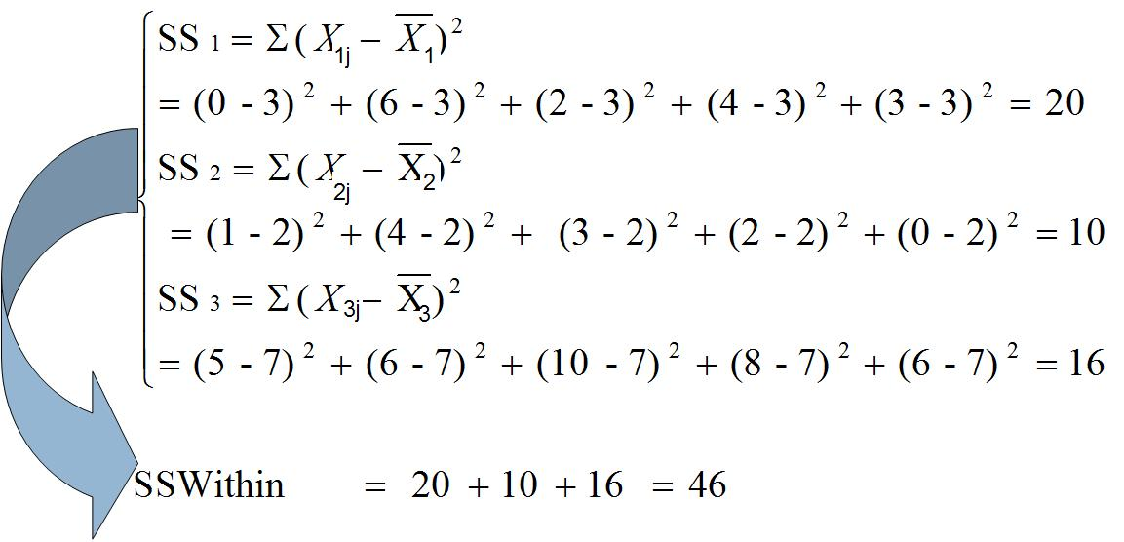
SS Within
Notes:
To calculate within group sum of squares we start with group 1 and calculate the sum of squared difference between observations and within group average. The average within this group is 3 and the squared difference of observed satisfaction rating and the average are summed to obtain 20

Slide 20
SS Within
Notes:
IN the second group the average is 2 and the sum of squared differences is calculated to be 10.

Slide 21
SS Within
Notes:
In the third group, the average is 7 and the sum of squared differences is calculated to be 16.

Slide 22
SS Within
Notes:
The within group sum of squared residuals is the sum of the 3 calculated value and is equal to 46.

Slide 23
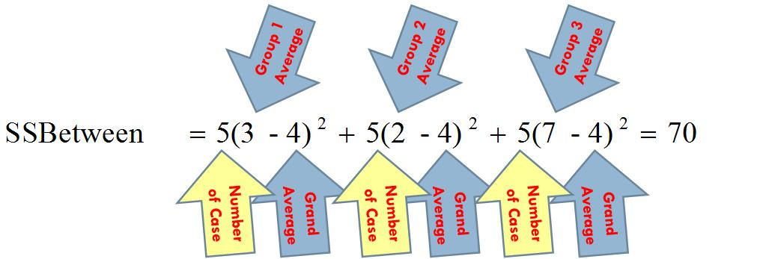
SS Between
Notes:
To calculate the sum of square for between groups we take group one average of 3 and subtract the grand average of 4. We square this difference and multiply by 5 which is the number of patients in group 1. This says that if everyone in this group had rated as the average, then the sum of the square contributed from this group to the calculation is 5 times the square of -1.

Slide 24
SS Between
Notes:
We did this for the second group which had an average of 2. The grand average was 4. There were 5 patients in this group.

Slide 25
SS Between
Notes:
We do the same for the last group. The calculated sum of square if all patients had rated their satisfaction as their average of the group is 70.

Slide 26
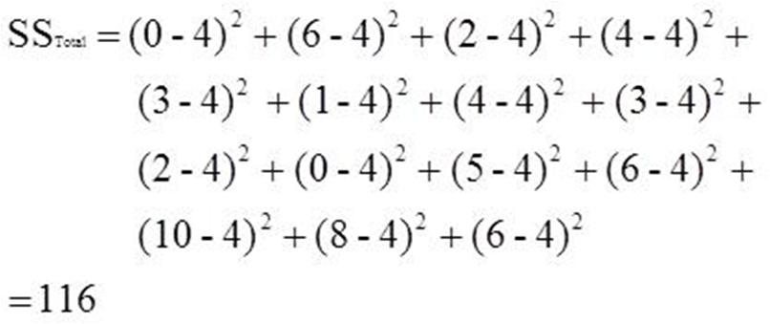
Sum of Squares Total
Notes:
The last calculation is the total sum of square which is the sum of the squared difference of observed satisfaction rating and grand average satisfaction rating. This sum of square is 116.

Slide 27
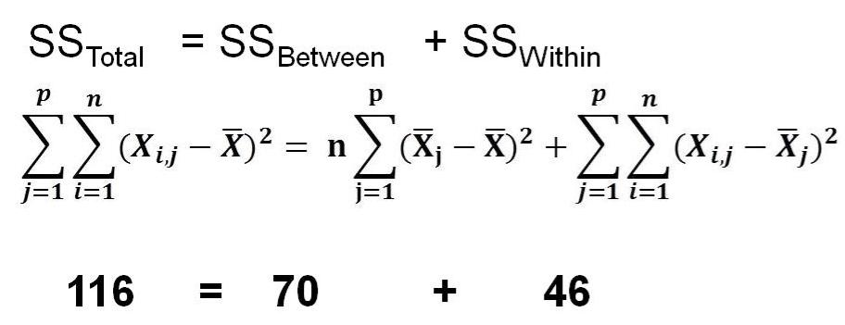
Components of Variance
Notes:
We could have done this also by summing the between and within sum of squares, getting the same answer.

Slide 28
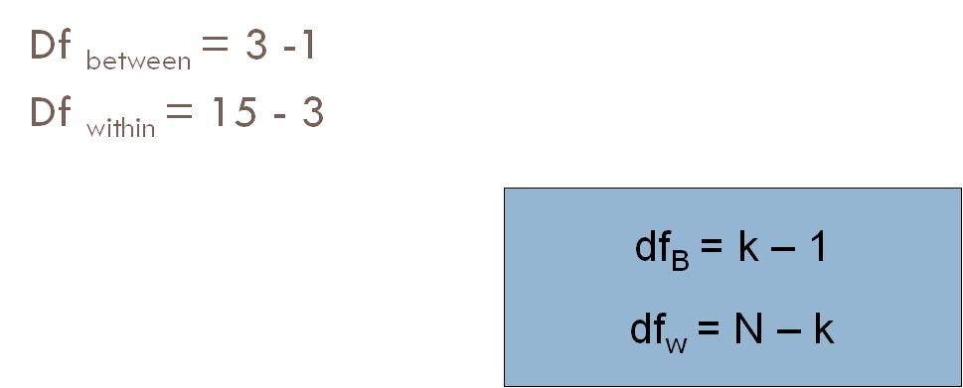
Degrees of Freedom
Notes:
The degrees of freedom for between sum of square is calculated as 3 groups minus 1. We always calculate degree of freedom as the number of estimates minus number of parameters estimated. Here we have 3 groups and 1 parameter estimated. The degrees of freedom for within groups is total number of observations 15 minus the 3 estimates used for average within groups.

Slide 29
F Test Statistic Calculations
Notes:
The mean sum of square for between groups is 70 divided by 2 degrees of freedom.

Slide 30
F Test Statistic Calculations
Notes:
The mean sum of square for within group is sum of square of 46 divided by 12 degrees of freedom.

Slide 31
F Test Statistic Calculations
Notes:
The F statistic is calculated as mean sum of square between group divided by mean sum of square within the group which is 9.13.

Slide 32
Lookup Critical Value
Notes:
This observed F statistic can now be compared to the F statistic at alpha 0.05, which is 3.88.

Slide 33
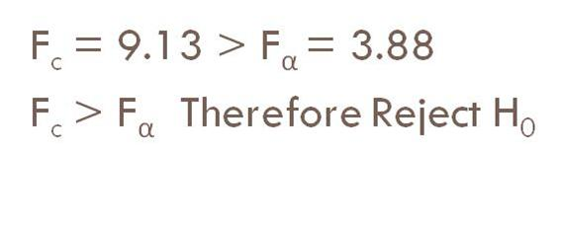
Conclusion
Notes:
Since the observed F statistic is larger than F statistic for alpha 0.05, therefore we reject the hypothesis that there are no group differences and that the means within each group could have come from same distribution.

Slide 34
Take home lesson
How to compare the mean of three or more samples
Notes:
This set of slides have shown you how to compare the mean of three or more samples

