Slide 1
Standard Normal Distribution
Farrokh Alemi Ph.D.
Notes:
This lecture was organized by Dr. Alemi. It is presented to you using an Avatar also organized by Professor Alemi

Slide 2
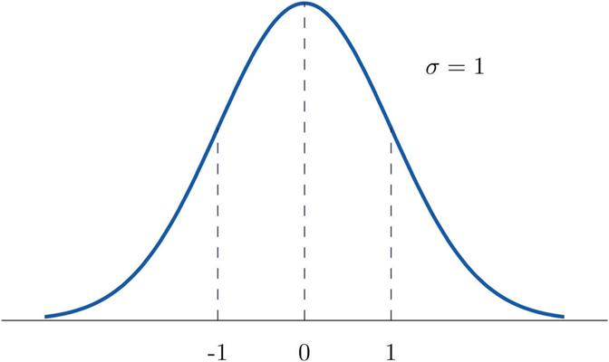
Standard
Normal
Notes:
A standard normal distribution has a mean of 0 and a standard deviation of 1.

Slide 3
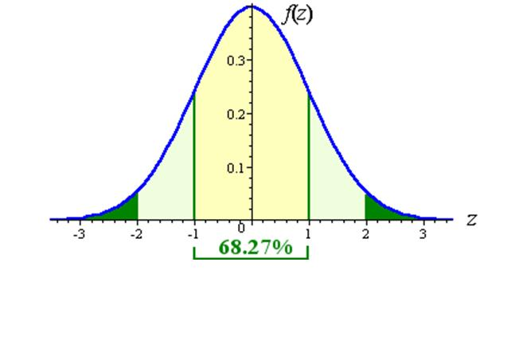
Notes:
68.27% of data fall within 1 standard deviation of standard normal curve. The area marked in yellow.

Slide 4
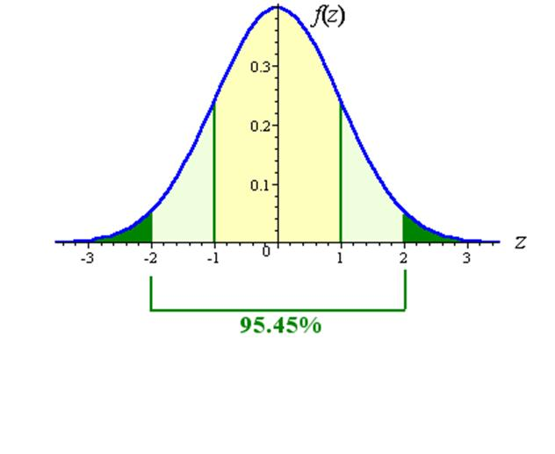
Notes:
95.45% of the data fall within 2 standard deviations. This is the white and the yellow area under the standard normal curve shown here.

Slide 5
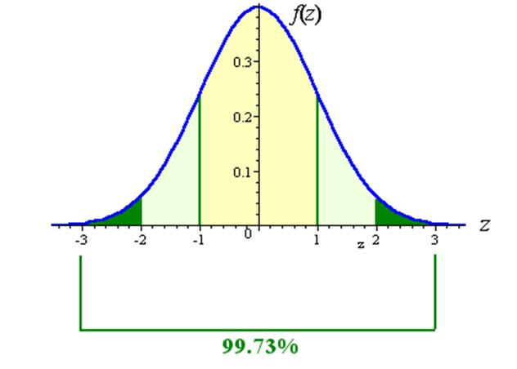
Notes:
99.73% of data fall within 3 standard deviation of standard normal curve.

Slide 6
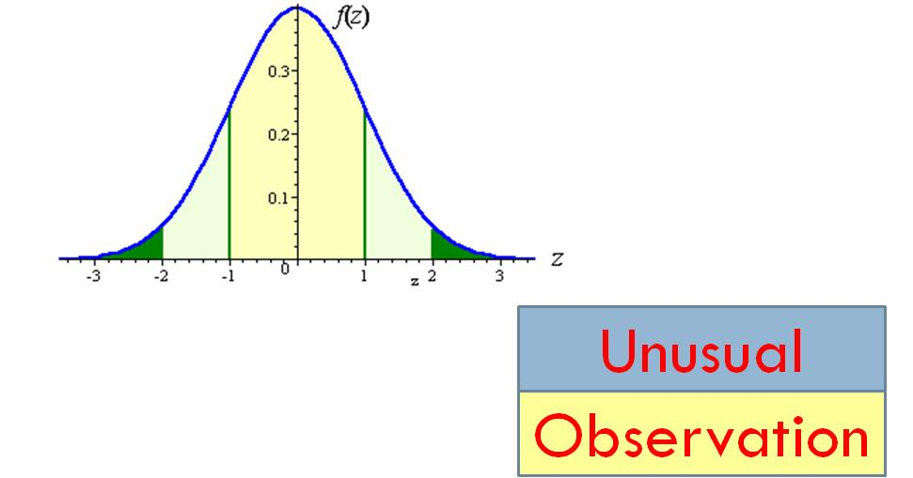
Notes:
Knowing how many standard deviations an observation is an observation away from the mean of a distribution tells us the probability of how likely it is to observe it. This provides an easy method of understanding how unusual an observation is.

Slide 7
84%
Notes:
An observation becomes less frequent and more unusual depending on number of standard deviations it is away from the mean. At 1 standard deviation, 84% of observations fall below it.

Slide 8
98%
Notes:
At 2 standard deviations, 98% of observations fall below it.

Slide 9
99%
Notes:
At 3 standard deviations, 99% of the observations fall below it. The chances of observing a value more than 3 standard deviation away from the mean falls below 1 in 100.

Slide 10
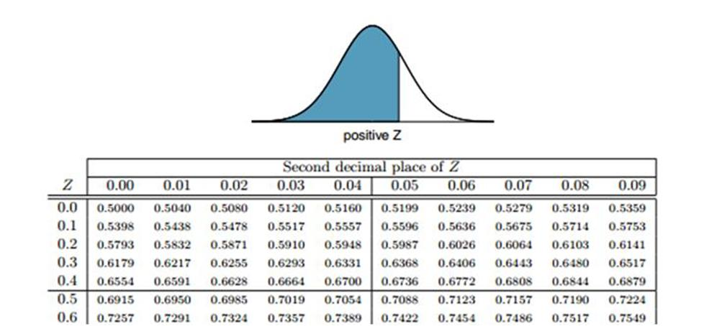
Standard Normal Tables
Notes:
Standard normal tables exists that tell us how common a value is based on how many standard deviation it is away from the mean. To count the number of standard deviation an observation is away from a mean, we need the Z score.

Slide 11
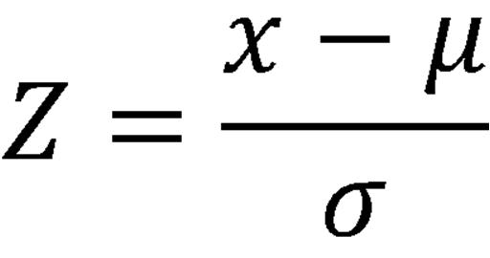
Z Score
Notes:
If the observation is one standard deviation above the mean, its Z score is 1. If it is 1.5 standard deviations below the mean, then its Z score is -1.5. This equation shows the Z score for an observation x that follows a distribution with mean µ and standard deviation σ. While the original distribution is centered around mean µ and has standard deviation of σ, the Z scores transform the distribution to a standard normal distribution.

Slide 12
Example
Assuming that patient ratings are normally distributed and we have 3 ratings of 3, 4, and 5. What is the mean and standard deviation?
Notes:
Let us take a very simple example to demonstrate the power of normal distribution. Assume that patient ratings are normally distributed and we have 3 ratings of 3, 4, and 5. What is the mean and standard deviation?

Slide 13
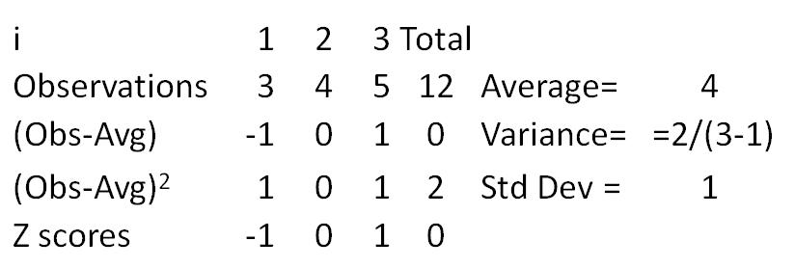
Example
Notes:
The mean is 4 and the standard deviation is 1. Given this mean and standard deviations we can answer other questions.

Slide 14
Example
If mean rating is 4 and the standard deviation is 1, what is the probability of observing a rating of 1?
Notes:
In this question we are asking how unusual it is to observe a rating of 1. To answer this question we need to calculate the Z value.

Slide 15
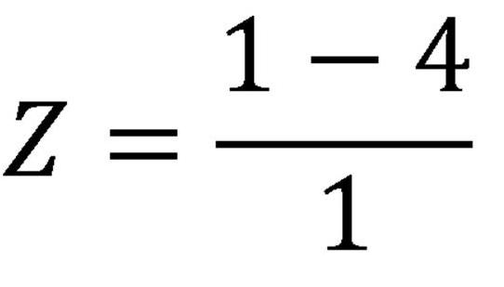
Notes:
The Z value is minus 3. We can now look up in standard normal tables to see what percent of values are more than 3 standard deviation below the mean.

Slide 16
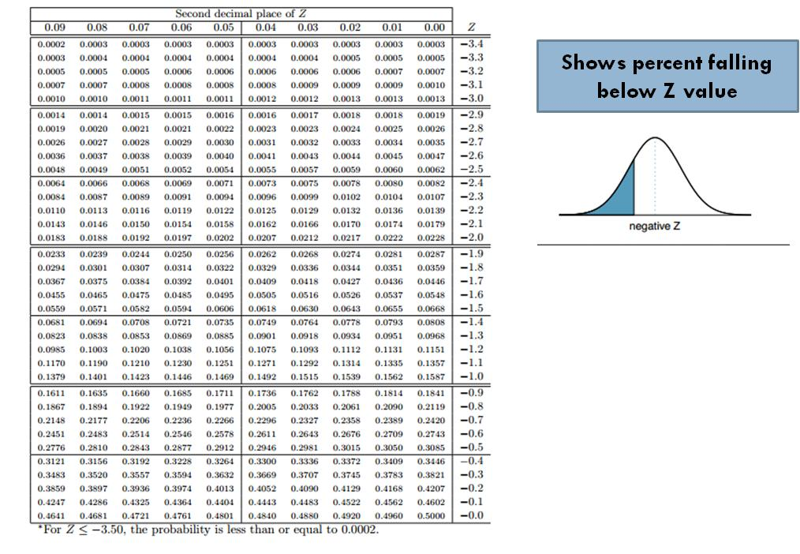
Standard Normal Table
Notes:
This shows a standard normal table. The columns show the last two digit of the Z score. The rows show the Z score to the first digit. The cell values give the percent of values falling below the Z score.

Slide 17
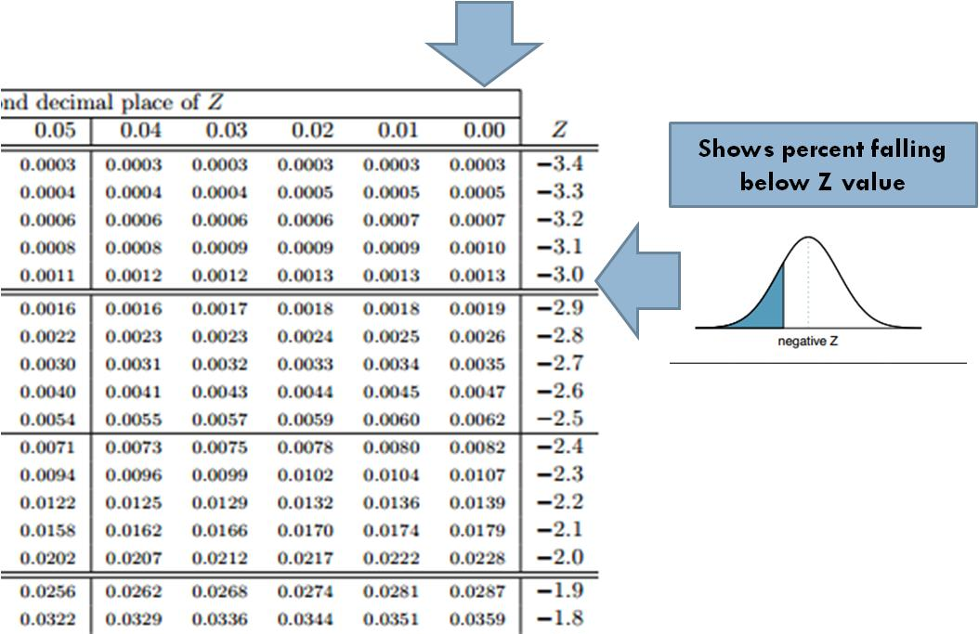
Notes:
Zooming in, we can select for the second digit the column corresponding with 0.00 and the row corresponding with -3.0.

Slide 18
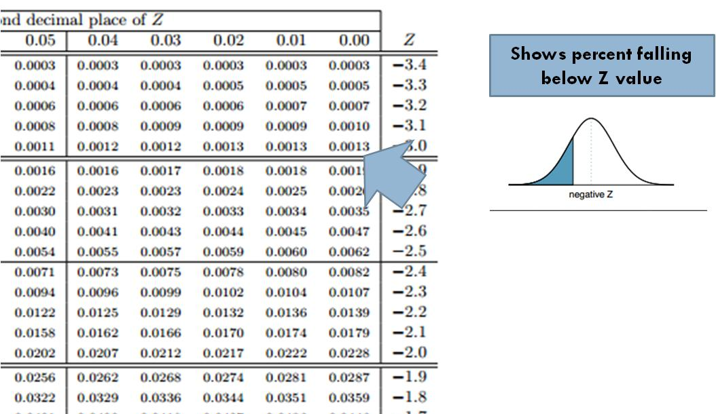
Notes:
We read that the probability of observing a Z of less than -3.00 is 0.0013. Therefore observing a rating of 1 is quite rare.

Slide 19
Standrad Normal Distribution
How rare an observation is?
Notes:
Normal distributions allow us to examine how rare it is to observe a sample value

