Slide 1
Summarizing data
Slides developed by Mine C¸ etinkaya-Rundel of OpenIntro and revised by Alemi.
The slides may be copied, edited, and/or shared via the CC BY-SA license. Some images may be included under fair use guidelines (educational purposes).

Slide 2
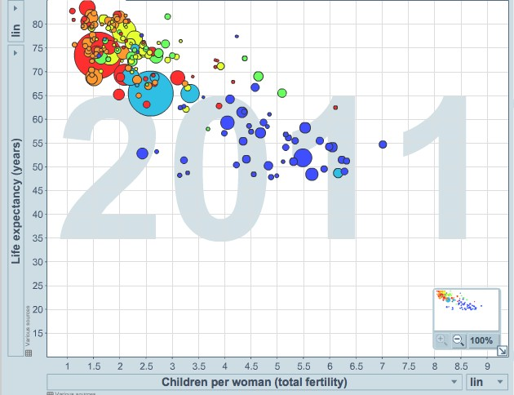
Scatterplot
http://www.gapminder.org/world
1
Notes:
Scatterplots are useful for visualizing the relationship between two numerical variables. Do life expectancy and total fertility appear to be associated or independent? They appear to be linearly and negatively associated: as fertility increases, life expectancy decreases. Was the relationship the same through- out the years, or did it change? The relationship changed over the years.

Slide 3
Dot plots
2.5
3.0
3.5
4.0
GPA
Notes:
Useful for visualizing one numerical variable. Darker colors represent areas where there are more observations. How would you describe the distribution of GPAs in this data set? Make sure to say something about the center, shape, and spread of the distribution.

Slide 4
Dot plots & mean
2.5
3.0
3.5
4.0
GPA
Notes:
The mean, also called the average (marked with a triangle in the above plot), is one way to measure the center of a distribution of data. The mean GPA is 3.59.

Slide 5
Mean
_{x¯ =} x₁ + x₂ + · · · + x_{n ,}
n
where x₁, x₂, · · · , x_{n} represent the n observed values.
Notes:
The sample mean, denoted as x¯, can be calculated as sum of the observations divided by number of observations. The population mean is also computed the same way but is denoted as µ. It is often not possible to calculate µ since population data are rarely available. The sample mean is a sample statistic, and serves as a point estimate of the population mean. This estimate may not be perfect, but if the sample is good (representative of the population), it is usually a pretty good estimate.

Slide 6
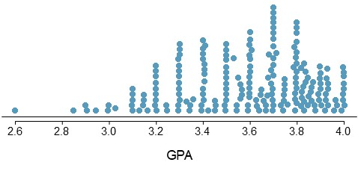
Stacked dot plot
Notes:
Higher bars represent areas where there are more observations, makes it a little easier to judge the center and the shape of the distribution.

Slide 7
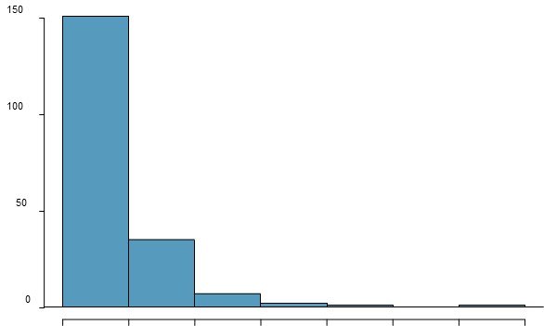
Histograms - Extracurricular hours
0
10
20
30
40
50
60
70
Notes:
Histograms provide a view of the data density. Higher bars represent where the data are relatively more common. Histograms are especially convenient for describing the shape
of the data distribution. The chosen bin width can alter the story the histogram is telling.

Slide 8
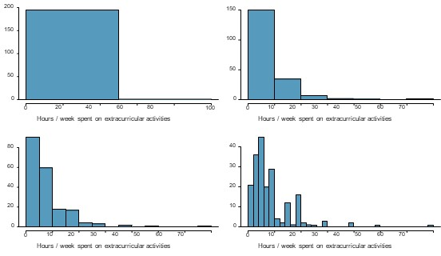
Bin width
Notes:
Which one(s) of these histograms are useful? much about the data? Which hide too much? Which reveal too much.

Slide 9
Shape of a distribution: modality
0
0
0
0
0
0
0
Notes:
Does the histogram have a single prominent peak (unimodal), several prominent peaks (bimodal/multimodal), or no apparent peaks (uniform)? Note: In order to determine modality, step back and imagine a smooth curve over the histogram – imagine that the bars are wooden blocks and you drop a limp spaghetti over them, the shape the spaghetti would take could be viewed as a smooth curve.

Slide 10
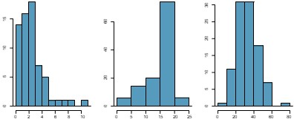
Shape of a distribution: skewness
Notes:
Is the histogram right skewed, left skewed, or symmetric? Note: Histograms are said to be skewed to the side of the long tail.

Slide 11
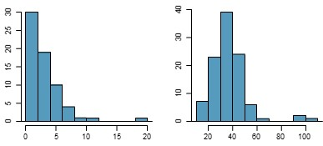
Shape of a distribution: unusual observations
Notes:
Are there any unusual observations or potential outliers?

Slide 12
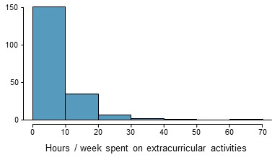
Extracurricular activities
Notes:
How would you describe the shape of the distribution of hours per week students spend on extracurricular activities?

Slide 13
Extracurricular activities
Notes:
How would you describe the shape of the distribution of hours per week students spend on extracurricular activities? Unimodal and right skewed, with a potentially unusual observation at 60 hours/week.

Slide 14
Commonly observed shapes of distributions
modality
12

Slide 15
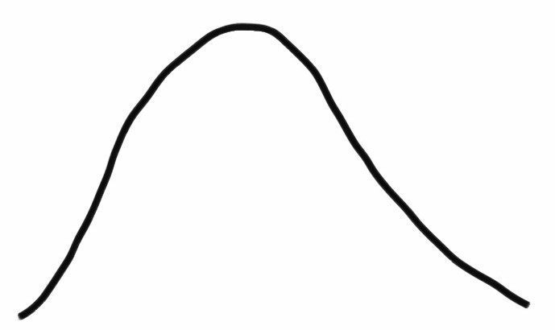
Commonly observed shapes of distributions
modality
unimodal
12

Slide 16
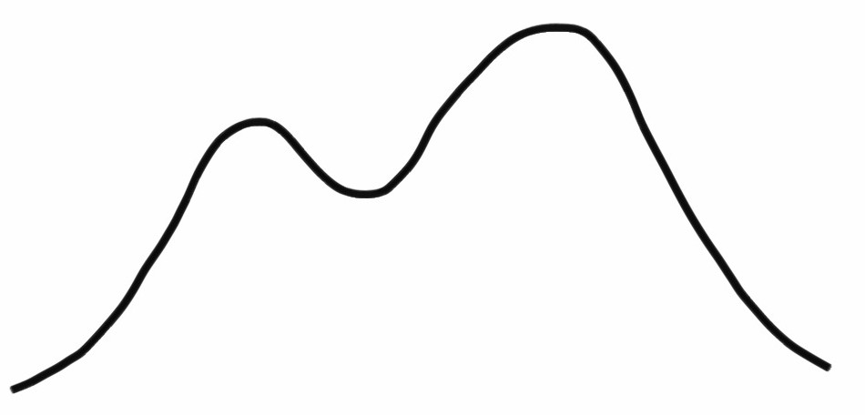
Commonly observed shapes of distributions
modality
unimodal
bimodal
12

Slide 17
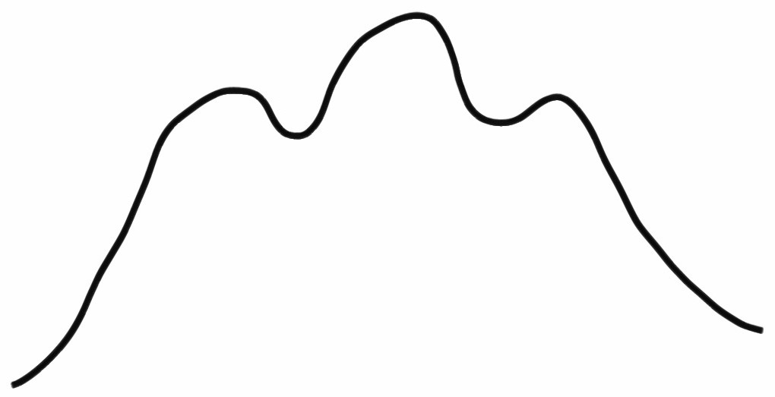
Commonly observed shapes of distributions
modality
unimodal
bimodal
multimodal
12

Slide 18
Commonly observed shapes of distributions
modality
uniform
unimodal
bimodal
multimodal
12

Slide 19
Commonly observed shapes of distributions
modality
uniform
unimodal
bimodal
multimodal
skewness
12

Slide 20
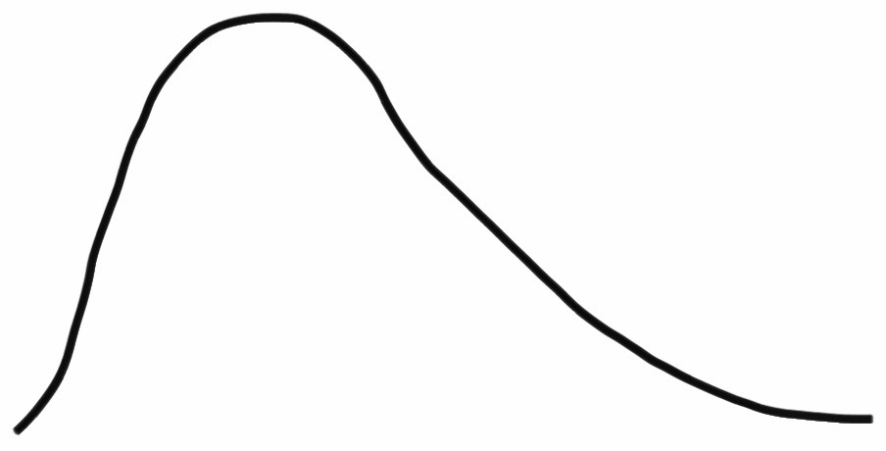
Commonly observed shapes of distributions
modality
uniform
unimodal
bimodal
multimodal
skewness
right skew
12

Slide 21
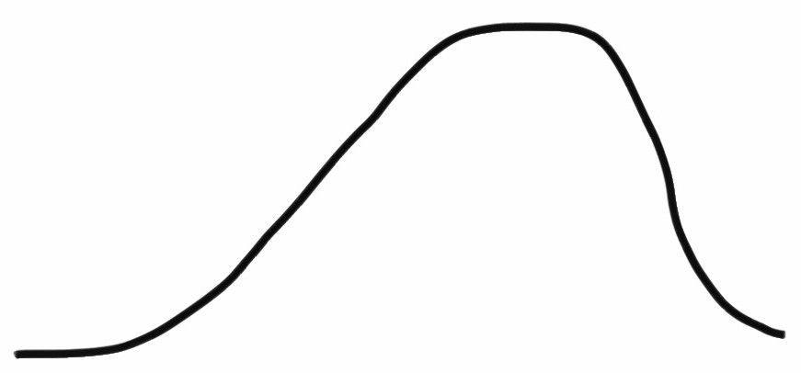
Commonly observed shapes of distributions
modality
uniform
unimodal
bimodal
multimodal
skewness
right skew
left skew
12

Slide 22
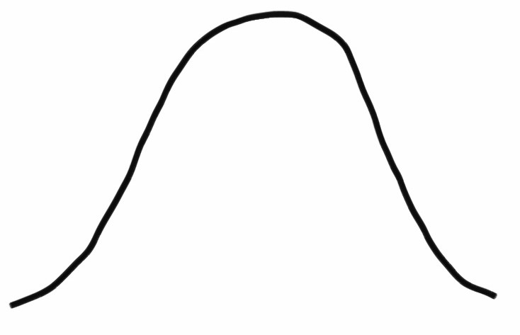
Commonly observed shapes of distributions
modality
uniform
unimodal
bimodal
multimodal
skewness
right skew
symmetric
left skew
12

Slide 23
Practice
Which of these variables do you expect to be uniformly distributed?
weights of adult females
salaries of a random sample of people from North Carolina
house prices
birthdays of classmates (day of the month)
13

Slide 24
Practice
Which of these variables do you expect to be uniformly distributed?
weights of adult females
salaries of a random sample of people from North Carolina
house prices
birthdays of classmates (day of the month)
13

Slide 25
Application activity: Shapes of distributions
Sketch the expected distributions of the following variables:
Infection rate in counties
scores on an exam in this course
Average grades of 20 students across health informatic courses
Come up with a concise way (1-2 sentences) to teach someone how to determine the expected distribution of any variable.

Slide 26
Are you typical?
http://www.youtube.com/watch?v=4B2xOvKFFz4
15

Slide 27
No one is typical. How to describe variation?
http://www.youtube.com/watch?v=4B2xOvKFFz4
15
Notes:
How useful are centers alone for conveying the true characteristics of a distribution?

Slide 28
Variance
16
Notes:
Variance is roughly the average squared deviation from the mean.

Slide 29
Variance
The sample mean is
x¯ = 6.71, and the sample size is n = 217.
The variance of amount of sleep students get per night can be calculated as:
60
40
20
0
6 8
Hours of sleep / night
2
4
10
12
_{s}2
(5 − 6.71)² + (9 − 6.71)² + · · · + (7 − 6.71)²
217 − 1
=
= 4.11 hours
2
Notes:
Why do we use the squared deviation in the calculation of variance? To get rid of negatives so that observations equally distant from the mean are weighed equally.
To weigh larger deviations more heavily.

Slide 30
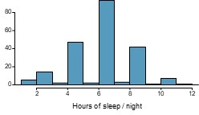
Standard deviation
$$s=\sqrt{s^{2}}=\sqrt{4.11}=2.03 hours$$
18
Notes:
The standard deviation is the square root of the variance, and has the same units as the data. We can see that all of the data are within 3 standard deviations of the mean.

Slide 31
Median
0, 1, 2, 3, 4
Notes:
The median is the value that splits the data in half when ordered in ascending order. If there are an even number of observations, then the median is the average of the two values in the middle. Since the median is the midpoint of the data, 50% of the values are below it. Hence, it is also the 50th percentile.

Slide 32
Q1, Q3, and IQR
The 25th percentile is also called the first quartile, Q1.
The 50th percentile is also called the median.
The 75th percentile is also called the third quartile, Q3.
Between Q1 and Q3 is the middle 50% of the data. The range these data span is called the interquartile range, or the IQR.
IQR = Q3 − Q1

Slide 33
Box plot
Notes:
The box in a box plot represents the middle 50% of the data, and the thick line in the box is the median.

Slide 34
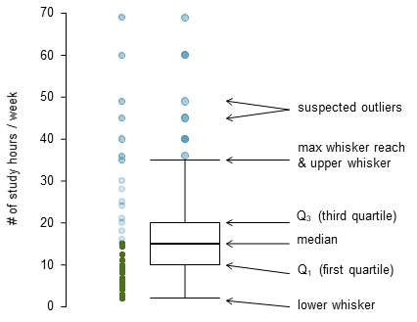
Anatomy of a box plot

Slide 35
Whiskers and outliers
max upper whisker reach = Q3 + 1.5 × IQR
max lower whisker reach = Q1 − 1.5 × IQR
IQR : 20 − 10 = 10
max upper whisker reach = 20 + 1.5 × 10 = 35
max lower whisker reach = 10 − 1.5 × 10 = −5
Notes:
Whiskers of a box plot can extend up to 1.5×IQR away from the quartiles. A potential outlier is defined as an observation beyond the maximum reach of the whiskers. It is an observation that appears extreme relative to the rest of the data.

Slide 36
Outliers (cont.)
Why is it important to look for outliers?

Slide 37
Outliers (cont.)
Why is it important to look for outliers?
Identify extreme skew in the distribution.
Identify data collection and entry errors.
Provide insight into interesting features of the data.

Slide 38
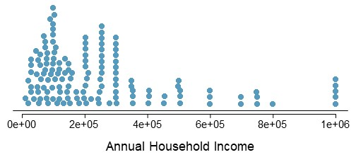
Extreme observations
25
Notes:
How would sample statistics such as mean, median, SD, and IQR of household income be affected if the largest value was replaced with $10 million? What if the smallest value was replaced with $10 million?

Slide 39
Robust statistics
●
●
●
●
●
●
●
●
●
●
●
●
●
●
●
●
●
●
●
●
●
●
●
●
●
●
● ●
● ● ●
● ● ● ●
● ● ● ● ●
● ● ● ●●● ●● ● ●● ● ● ● ●
●
●
●
●
●
●
●
●
●
● ● ●
●●●
●● ●● ●
● ●●●● ●
●
●●● ●
●●●●●●
●
●
●
●
●
●
● ●●●● ●
●
●●● ●● ●
●● ● ●● ●●
●
●
●
●
●
● ●●●●● ● ●●●●
● ●
● ● ●
4e+05 6e+05
Annual Household Income
0e+00
2e+05
8e+05
1e+06
scenario | robust median IQR | not robust x¯ s
original data | 190K 200K | 245K 226K
move largest to $10 million | 190K 200K | 309K 853K
move smallest to $10 million | 200K 200K | 316K 854K
26
Notes:
Median and IQR are more robust to skewness and outliers than mean and SD.

Slide 40
Robust statistics
for skewed distributions it is often more helpful to use median and IQR to describe the center and spread
for symmetric distributions it is often more helpful to use the mean and SD to describe the center and spread
27

Slide 41
Robust statistics
If you would like to estimate the typical household income for a student, would you be more interested in the mean or median income?
27

Slide 42
Robust statistics
If you would like to estimate the typical household income for a stu- dent, would you be more interested in the mean or median income?
Median
27

Slide 43
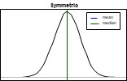
Mean vs. median
Notes:
If the distribution is symmetric, center is often defined as the mean since mean is equal to median. If the distribution is skewed or has extreme outliers, center is often defined as the median. Right-skewed if mean is greater than median; Left-skewed if mean is less than median

Slide 44
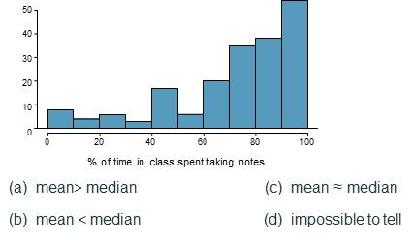
Practice
Notes:
Which is most likely true for the distribution of percentage of time actually spent taking notes in class versus on Facebook, Twitter, etc.?

Slide 45
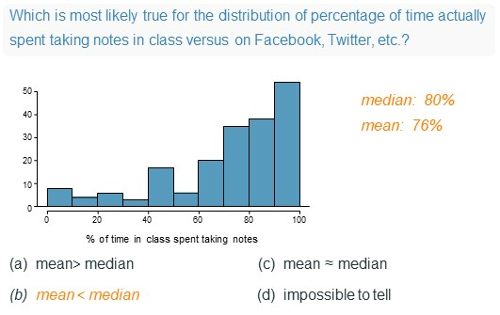
Practice

Slide 46
Extremely skewed data
Notes:
When data are extremely skewed, transforming them might make modeling easier. A common transformation is the log transformation. The histograms on the left shows the distribution of number of basketball games attended by students. The histogram on the right shows the distribution of log of number of games attended. Skewed data are easier to model with when they are transformed because outliers tend to become far less prominent after an appropriate transformation. However, results of an analysis in log units of the measured variable might be difficult to interpret.

Slide 47
Pros and cons of transformations
What other variables would you expect to be extremely skewed?
31

Slide 48
Pros and cons of transformations
What other variables would you expect to be extremely skewed?
Salary, housing prices, etc.
31

Slide 49
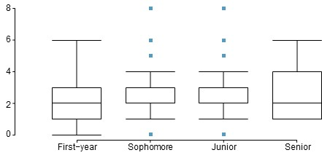
Practice with Side-by-side box plots
Notes:
Does there appear to be a relationship between class year and number of clubs students are in?

